Slide 1
MICROSOFT CONFIDENTIAL. FOR INTERNAL AND PARTNER USE ONLY.
This deck is designed to train Partner sellers upsell their existing customer base with a “+One” approach.
Identify the customer’s current situation and pain points
Understand the products they have and where you want to take them
Ask the right questions and listen
Describe the value of the upsell in customer terms
Be ready to counter common objections
Know your competition
Legal notice: The information herein is for informational purposes only and represents the current view of Microsoft Corporation as of the date of this presentation. Because Microsoft must respond to changing market conditions, it should not be interpreted to be a commitment on the part of Microsoft, and Microsoft cannot guarantee the accuracy of any information provided after the date of this presentation. Microsoft may make changes to specifications and product descriptions at any time, without notice.
MICROSOFT MAKES NO WARRANTIES, EXPRESS, IMPLIED OR STATUTORY, AS TO THE INFORMATION IN THIS PRESENTATION. NO LICENSE, EXPRESS OR IMPLIED, BY ESTOPPEL OR OTHERWISE, TO ANY INTELLECTUAL PROPERTY RIGHTS IS GRANTED BY THIS PRESENTATION.

Slide 2


The world’s productivity cloud
Personal Productivity
Organizational Productivity
Improve individual performance
Drive growth and increase efficiency

Slide 3





Microsoft 365 Portfolios
Start by identifying what type of customer you are talking to
Consumer
For Home
Microsoft 365 Personal
Microsoft 365 Family
Microsoft 365 Business Basic
Microsoft 365 Business Standard
Microsoft 365 Business Premium
SMB (<300)
For Business
Frontline
For Deskless
Microsoft 365 F1
Microsoft 365 F3
Office 365 E1
Office 365 E3 / EMS E3 / Windows E3
Office 365 E5 / EMS E5 / Windows E5
Microsoft 365 E3
Microsoft 365 E5
Enterprise (>300)
For Enterprise
Microsoft 365 A1
Microsoft 365 A3
Microsoft 365 A5
Academic
For Education

Slide 4

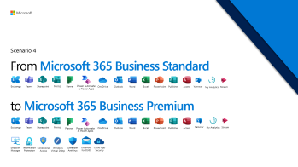
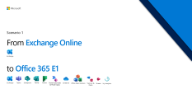
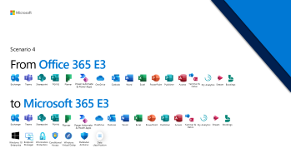
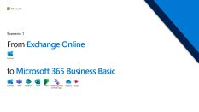
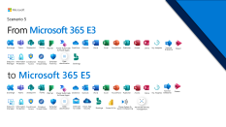
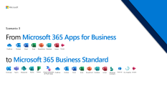

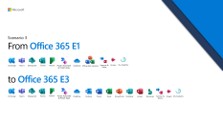



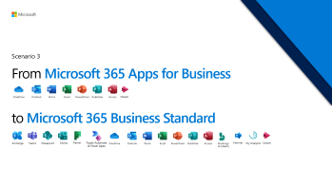

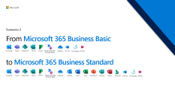
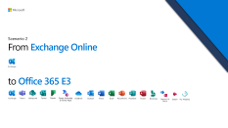
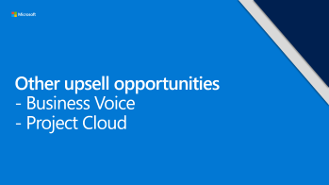




Scenarios Menu | Navigating the deck
Microsoft 365 for Business
Microsoft 365 for Enterprise

Slide 5





Business Portfolio Upsell Framework
Based on Land & Expand (LXP)
WE SMB Mid-Market Upsell | M365 BP | M365 BP + Business Voice / Phone System
AAD | M365 BS + Defender for O365 | M365 BS + Defender for O365 + Business Voice
On-Prem, stand server, M365 BB, Apps for B | M365 BS | M365 BS + Business Voice
3B
3C
Advanced Security
Surface
2A
2B
Security Upsell →
Basic
Security
Surface
Surface, MS Teams Devices & Meeting Rooms
1A
1B
No Security
No Teams
Teams (O365)
Teams + Voice
Teams Upsell →

Slide 6

WE SMB Mid-Market Upsell | M365 BP + Surface Unify communication and increase productivity with Teams calling capabilities Sales Play: Security & M365 BP (Partner Playbook) Unify communications Surface Choose solution & prove the value SMB Workshop Tool: Help me choose a solution Demo: Voice set up guide, Phone System, Teams Meetings & Business Voice (US) | M365 BP + Business Voice + Surface & Teams Devices Drive usage, further expand with Power BI, Surface, Meeting Rooms & MS Teams devices Sales Play: Power Bi Surface Demo: Power BI Productivity, PowerPlatform & Teams Meetings
AAD Help customers adopt Secure Remote Work with M365 BP Sales Play: Secure Remote Work Security & M365 BP (Partner Playbook) Choose solution & prove the value SMB Workshop Tool: Help me choose a solution Demo: M365 BP, Secure Score, Teamwork CIE & Modern Collab | M365 BS + Defender for O365 Consolidate IT with Device Management and Security with M365 BP Sales Play: Security (Upsell) Surface Choose solution & prove the value SMB Workshop Tool: Help me choose a solution & SMB Voice Workshop Demo: M365 BP & Secure Score
On-Prem, stand server, M365 BB, Apps for B Help customers begin the journey to work securely remote with M365 BS + Defender for O365 Sales Play: Secure Remote Work Choose solution & prove the value SMB Workshop Tool: Secure Remote work Demo: Teamwork CIE , Modern Collab, Teams & Defender for O365 | M365 BS Begin Security journey with Defender for O365 to protect from key threats (safe links & safe attachments) Sales Plays: Security & M365 BP (Partner Playbook) Choose solution & prove the value SMB Workshop Tool: Secure Remote work workshop Demo: Defender for O365 & Secure Score
Advanced Security
3B
Security Upsell →
Basic
Security
2A
2B
No Security
1A
1B
3C
No Teams
Teams
Teams + Voice
Teams Upsell →

Slide 7
Enterprise Portfolio Upsell Framework
Based on Land & Expand (LXP)
 | Microsoft 365 E5 Security & Compliance Add-Ons | Microsoft 365 E5
AAD or EMS E3 | Microsoft 365 E3 | Microsoft 365 E5
On-Prem, stand server, E1, Apps for E | Office 365 E3/E5 | Office 365 E3 + E5 Teams Voice
3B
3C
Advanced Security (E5)
Surface
2A
2B
Security Upsell →
Basic
Security
(AAD/EMS E3)
Surface
Surface, MS Teams devices & Meeting Rooms
1A
1B
No Security
No Teams
Teams (O365)
Teams + Voice
Teams Upsell →

Slide 8
WE Top Unmanaged Upsell | Microsoft 365 E5 Security & Compliance Add-Ons Unify communication and increase productivity with Teams calling capabilities Sales Play: Unify communications Meeting Rooms Surface Choose solution & prove the value Demo: Phone System Workshops: Cloud accelerators (Teams Calling, Teams Apps & Solutions & Endpoint Management) | Microsoft 365 E5 Drive usage, further expand with Surface, Meeting Rooms, Viva, Azure Sentinel & MS Teams devices Sales Play: Surface Viva Choose solution & prove the value Workshops: Cloud Accelerator (Teams Apps & Solutions & Azure Sentinel) and Viva Discover Workshop
AAD Help customers adopt Secure Hybrid Work with M365 E3 Sales Play: Teams, Productivity & Meeting Rooms Security & compliance Choose solution & prove the value Demo: M365 E3, Secure Score & Teams meetings Workshops: Discover, Solution Assessment as a service (workplace modernization & Cyber Security) and Cloud Accelerators (Secure Work from Anywhere) | Microsoft 365 E3 Bring Advanced Security and Compliance capabilities with M365 E5 add-ons Sales Play: Security (Upsell) Surface Meeting Rooms Choose solution & prove the value Demo: Defender for O365 & Secure Score Workshops: Solution Assessment as a service (cyber security) and Cloud Accelerator (Security & Compliance)
On-Prem, stand server, E1, Apps for E Help customers modernize collaboration Sales Play: Teams, Productivity & Meeting Rooms Choose solution & prove the value Demo: Teamwork CIE , Modernizing productivity, Teams Teams meetings, Teams Security Workshops: Discover, Solution Assessment as a service (workplace modernization) and Cloud Accelerators (Secure Work from Anywhere) | Office 365 E3/E5 Add Security and Compliance with Microsoft 365 E3, with full EMS E3 and Windows Enterprise E3 Sales Plays: Security & Compliance Choose solution & prove the value Demo: M365 E3, Secure Score & Teams meetings Workshops: Solution Assessment as a service (cyber security), Cloud Accelerator (Identity & Security)
Advanced Security
3B
Security Upsell →
Basic
Security
2A
2B
No Security
1A
1B
3C
No Teams
Teams
Teams + Voice
Teams Upsell →

Slide 9
Microsoft 365 for Business

Slide 10



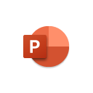



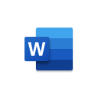











What do we sell?
Cloud Services
Exchange
Teams
Sharepoint
OneDrive
Forms
Web versions of
Word, Excel, PPT
Planner
Power Automate
& Power Apps
Bookings
Desktop Applications
Outlook
Word
Excel
PowerPoint
Publisher
Access
Advanced Security
& Device Management
Endpoint Manager
Information Protection
Conditional Access
Windows Virtual Desktop
Defender
Antivirus
Defender for O365
Cloud App Security

Slide 11
SMB Hero SKUs
Microsoft 365 Apps
Desktop Applications (+OneDrive)
OneDrive
Outlook
Word
Excel
PowerPoint
Publisher
Access
Microsoft 365 Business Basic
Cloud Services
Exchange
Teams
Sharepoint
OneDrive
Forms
Web versions of
Word, Excel, PPT
Planner
Power Automate
& Power Apps
Microsoft 365 Business Standard
Cloud Services
Desktop Applications
Exchange
Teams
Sharepoint
OneDrive
Forms
Web versions of
Word, Excel, PPT
Planner
Power Automate
& Power Apps
Bookings
Outlook
Word
Excel
PowerPoint
Publisher
Access
Microsoft 365 Business Premium
Cloud Services
Desktop Applications
Advanced Security & Device Management
Exchange
Teams
Sharepoint
OneDrive
Forms
Web versions of
Word, Excel, PPT
Planner
Power Automate
& Power Apps
Bookings
Outlook
Word
Excel
PowerPoint
Publisher
Access
Endpoint Manager
Information Protection
Conditional Access
Windows Virtual Dsktp
Defender
Antivirus
Defender for O365
Cloud App Security

Slide 12



Hidden gems in M365 Business Basic, Standard and Premium
 | Build apps in hours -not months- that easily connect to data, use Excel-like expressions to add logic, and run on the web, iOS, and Android devices. |  | Organize teamwork with intuitive, collaborative, visual task management. Create Kanban boards using content-rich task cards with files, checklists, labels, and more. Collaborate in Planner and Microsoft Teams and check visual status charts—all in the Microsoft cloud.
 | Include powerful workflow automation directly in your apps with a no-code approach that connects to hundreds of popular apps and services |  | Stay organised, focused, and in charge. Tackle anything from small scale projects to large initiatives. From project management to campaign management, office moves to event planning, be in control with a powerful, easy-to-use app. M365 Business B/S/P include a read only version of Project for the web
 | Streamline appointment scheduling and management with an easy to customize tool. Help your staff stay on top of their schedule and avoid double-bookings. An easy to navigate webpage lets your customers find and book appointments around the clock. |  | Work smarter with personal productivity insights with Insights by MyAnalytics. Don’t miss any important emails or forget a commitment you made to your co-workers. Understand how you spend your day. Get reminded to set 1:1 meetings with your manager, direct reports, or other top collaborators and get notified if an upcoming meeting doesn't have a quorum
 | Deliver live and on-demand events with an internal vide streaming service. Enhance your communications, company meetings, and training with events for up-to 10,000 attendees. Whether at home, work, or on the go - everyone has a seamless video experience across web and mobile apps
Power Apps
Planner
Power Automate
Project for the web
Bookings
Insights
Stream

Slide 13
Security Features in M365 Business Premium
 | Gets endpoint security, device management, and intelligent cloud actions in a unified management platform with Microsoft Intune and Configuration Manager. Helps secure, deploy, and manage all users, apps, and devices without disruption to existing processes. |  | Microsoft Defender Antivirus is the next-generation protection component of Microsoft Defender Advanced Threat Protection (Microsoft Defender ATP). Next-generation protection brings together machine learning, big-data analysis, in-depth threat resistance research, and the Microsoft cloud infrastructure to protect devices in your enterprise organization.
 | Azure Information Protection for Microsoft 365 protects important information from unauthorized access, enforces policies that improve data security, and helps enable secure collaboration. |  | Microsoft Defender for Office 365 safeguards your organization against malicious threats posed by email messages, links (URLs), and collaboration tools.
 | Conditional Access is a capability of Azure Active Directory that enables you to enforce controls on the access to apps in your environment, all based on specific conditions and managed from a central location. |  | Identify and combat cyberthreats across all your cloud services with Microsoft Cloud App Security, a cloud access security broker (CASB) that provides multifunction visibility, control over data travel, and sophisticated analytics.
 | Access Windows 10 desktops on any device, from anywhere. Provide employees the best virtualized experience with the only solution fully optimized for Windows 10 and Office 365
Endpoint
Manager
Defender
Antivirus
Information
Protection
Defender for O365
Conditional Access
Cloud App Security
Windows Virtual Desktop

Slide 14
Upsell Scenarios | Business SKU Summary
Exchange
Teams
Sharepoint
Forms
Power Automate
& Power Apps
Defender for O365
Cloud App Security
Planner
OneDrive
Outlook
Word
Excel
PowerPoint
Publisher
Access
Bookings
Endpoint manager
Information Protection
Conditional Access
Windows Virtual Dsktp
Defender
Antivirus
Email
M365 Business Basic
M365 Apps
M365 Business Standard
M365 Business Premium
From: Exchange Online ($4) | From: M365 Business Basic ($5) | From: M365 Apps ($8.25) | From: M365 Business Standard ($12.5) | From: Office 365 E3* ($20)
Create a hub for teamwork to connect with your teams and customers via chat, call or videoconference and collaborate. Access web versions of Office apps: Outlook, Word, Excel, PowerPoint, OneNote. Store and share files with 1 TB of file storage in the cloud per user. Co-author files in real time, auto-save to avoid loosing progress, keep backups and recover old versions when needed. Create simple forms, surveys and polls Manage tasks (personal/groups) and stay on track with Planner and its Teams integration Automate processes, develop apps without the need of coding skills | AI-infused desktop apps connected to cloud services. Always up-to-date. Install in up to 5 PCs/Macs, 5 tablets and 5 mobile devices concurrently Make amazing content with Editor, Designer, Tap, Presenter Coach Get work done faster with Dictation, Researcher, Insert Data from Picture Work together across apps with real-time Co-authoring, @mentions and Teams-Office apps integration Keep current always with Version History, Shared with Me, While You Were Away Draw visualized insights with New data types, Ideas, XLOOKUP Streamline appointment scheduling and automatically track milage as you drive | Host email (50GB mailbox) with your custom domain and stay on top of your email and calendar anywhere, on any device Create a hub for teamwork to connect with your teams and customers via chat, call or videoconference and collaborate Access web versions of Office apps: Outlook, Word, Excel, PowerPoint, OneNote. Easily create forms, surveys and polls Manage tasks (personal/groups) and stay on track with Planner and its Teams integration Automate processes, develop apps without the need of coding skills Streamline appointment scheduling and automatically track milage as you drive | Defend your business against advanced cyberthreats with sophisticated malware, phishing and ransomware protection. Control access to sensitive information using encryption, Conditional Access and self-password reset Protect your data from accidental or intentional leaks by restricting copy/paste/forward, Data Loss Prevention policies Secure devices that connect to your data and help keep iOS, Android, Windows, and Mac devices safe and up to date (MAM/MDM), remote wiping lost/stolen devices. Deploy Windows devices remotely with Autopilot Get visibility and manage risk of cloud apps being used across your organisation Provide remote access to secure Virtual Windows Desktop environments | Defend your business against advanced cyberthreats with sophisticated malware, phishing and ransomware protection. Control access to sensitive information using encryption, Conditional Access and self-password reset Protect your data from accidental or intentional leaks by restricting copy/paste/forward, Data Loss Prevention policies Secure devices that connect to your data and help keep iOS, Android, Windows, and Mac devices safe and up to date (MAM/MDM), remote wiping lost/stolen devices. Deploy Windows devices remotely with Autopilot Get visibility and manage risk of cloud apps being used across your organisation Provide remote access to secure Virtual Windows Desktop environments
To: Microsoft 365 Business Basic ($5) | To: M365 Business Standard ($12.5) | To: M365 Business Standard ($12.5) | To: M365 Business Premium ($20) | To: M365 Business Premium ($20)
*Note some customers on Office 365 E3 may require on-premise CALs that are not included in M365 Business Premium

Slide 15
FY 22 BOM Evolution
Plan supports FY22 priorities and stories and incorporates feedback received on FY21 BOM.
SMB General Resources
Existing FY21 resources will be refreshed and updated
FY22 Stories
New and refreshed resources will be provided. Combine assets where possible to maximize impact.
MPF
Messaging and Positioning Framework will reflect the latest M365 pitch evolution.
Storybook
Internal and External Storybook will be refreshed with new data and updated talking points.
zoom and google compete
Adapt selected partner-ready existing compete content to scale for SMB.
Story: Why Microsoft 365 cloud
Pitch deck, vendor telesales scripts and conversation guide will be produced. Content will be new, leveraging existing FY21 assets where appropriate.
Story: Secure your business and work from anywhere
Upsell to Business Premium. Pitch deck, vendor telesales scripts and conversation guide. Refresh assets in Partner Playbook.
Story: Advanced unified communication
Upsell to Business Voice. Pitch deck, vendor telesales scripts and conversation guide. Refresh existing assets and add new as needed.
Notes:
On the Zoom and Google compete content, Kamila is working with Compete team to leverage existing partner-ready content for FY22.

Slide 16





Scenarios Menu | Business SKUs
Click to drill down

Slide 17

From Exchange Online to Microsoft 365 Business Basic
Scenario 1
Exchange
Exchange
Teams
Sharepoint
Forms
Planner
Power Automate
& Power Apps
OneDrive
Stream

Slide 18
Customer Profile
From Exchange Online…
Productivity
Communication
On-premises file storage that requires access to office network. Files are hard to find
May be paying for a 3rd Party cloud storage app (e.g. Dropbox) and not know about OneDrive
Shares documents as email attachments and must wait for recipient to make edits and send it back. May need to pay extra for increased inbox capacity
Users occasionally loose information as they forget to save progress when working on files
Uses multiple applications to chat (e.g. Whatsapp) and do videoconferences (e.g. Zoom) – disjointed user experience
Dealing with multiple vendors make it hard to manage applications and keep them secured and control where data & confidential info lives
Receives inbound calls to a fixed landline in an office (impacted business continuity during COVID lockdown)
May be paying for an on-premises PBX (private brunch exchange) to receive calls, rout to different departments and take voicemails. Incurs in hardware and software maintenance costs
Task Management
Customer Insights
Keeps a list of to-dos on paper to organize their day and avoid forgetting important tasks
May use a whiteboard and sticky notes to assign tasks to project members and keep track of progress/completion
Depends on verbal feedback from customers to improve which may not usually happen
May pay for a 3rd party application (e.g. Survey Monkey) to capture customer feedback

Slide 19
Additional Value
…to Microsoft 365 Business Basic
 | Chat, Meet, Call and Collaborate in a single app with Video conferencing, Screen sharing, Custom backgrounds, Together mode, File sharing and collaboration, Apps integration, Workflows automation and built-in Privacy & Security. |  | Collect data and make better decisions with an easy form to create polls, surveys and quizzes. Built-in AI provides smart recommendations to do the heavy lifting for you. Visualize data in seconds with powerful, real-time charts and automatically generated reports.
 | Company intranet packed with intelligent features and available from anywhere. Share and manage content, knowledge, and applications to empower teamwork, quickly find information, and seamlessly collaborate across the organization. |  | Organize teamwork with intuitive, collaborative, visual task management. Create Kanban boards using content-rich task cards with files, checklists, labels, and more. Collaborate in Planner and Microsoft Teams and check visual status charts—all in the Microsoft cloud.
 | Enjoy 1TB storage per user to access and protect your business and school work with this intelligent files app. Share and collaborate from anywhere, on any device. Back up, protect and recover files from accidental deletes or malicious attacks |  | Include powerful workflow automation directly in your apps with a no-code approach that connects to hundreds of popular apps and services Build apps in hours -not months- that easily connect to data, use Excel-like expressions to add logic, and run on the web, iOS, and Android devices.
 | Access Word, Excel and PowerPoint from anywhere on your favourite browser. Enjoy the familiar Office experience you know and trust. Share your documents with anyone and work together in real-time
Teams
Forms
Sharepoint
Planner
OneDrive
Power Automate
& Power Apps
Web versions of
Word, Excel, PPT

Slide 20
Probing Questions
Customer Challenges
Microsoft 365 Business Basic Solutions
Productivity
How can your employees stay productive outside of the office? Can they access files and collaborate securely?
How do your employees share and co-author files? Do they have to send files back and forth? What happens if the file owner is away?
How do you run customer, partner or employee surveys?
Productivity
Enable a central repository so team members can access and view files in a single place from anywhere
Share, edit, and co-author Word, Excel, and PowerPoint files, all within Microsoft Teams.
Provide intelligent email and calendaring capabilities available on any device and run surveys easily with Forms.
Meetings
Tell me about how you manage meetings from the set up, to the meeting and the follow up? (scheduling, running engaging and effective online meetings and following up on actions)
How do you run online meetings with external customers or partners? Can you easily adapt your video background with blurred background or a company logo?
Can you make phone calls across devices with Teams and dial into meetings with your phone number (Business Voice add-on required)
Meetings
Host online meetings with anyone inside or outside your organization and look more professional with blurred and custom backgrounds (ex company logo). View up to 49 attendees in the Gallery View
Manage the whole meeting cycle effectively with scheduling assistant, video, screen sharing, whiteboard and shared notes
Use Teams as your Phone and make phone calls across devices with a cloud-based phone system (Business Voice add-on required)
Lower your IT spend by consolidating solutions!
Point solutions are expensive and time consuming to manage (Microsoft 365 is the best of breed and the best platform. Consolidate & save!)
Reduce on-prem infrastructure, hardware, licensing and maintenance costs and move IT spend from CapEx to OpEx with Cloud solutions
Google Workspace Business Starter (equivalent to M365 Business Basic) costs 21% more

Slide 21
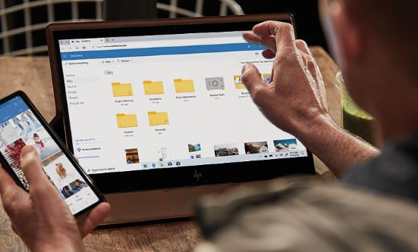
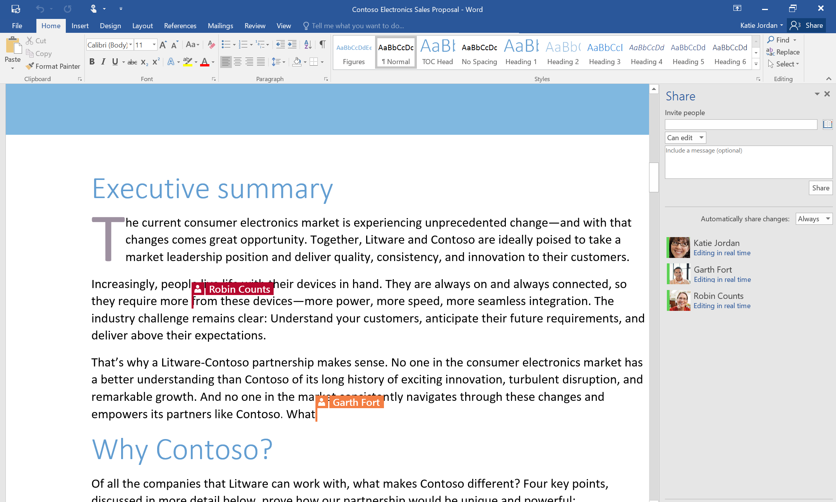
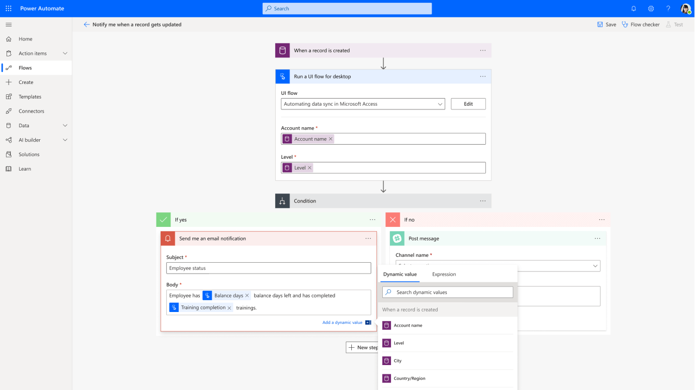
Enhancing Productivity
File storage and sharing
Save files in the cloud, access them from anywhere and share with confidence.
Keep a single version of the file, share them with links instead of attachments and restore old versions with a single click
Productivity Apps (web)
Get the web versions of the familiar Office apps like Word, Excel, and PowerPoint
Collaborate in real-time with others on documents directly from your browser
Process Automation
Include powerful workflow automation directly in your apps with a no-code approach that connects to hundreds of popular apps and services

Slide 22
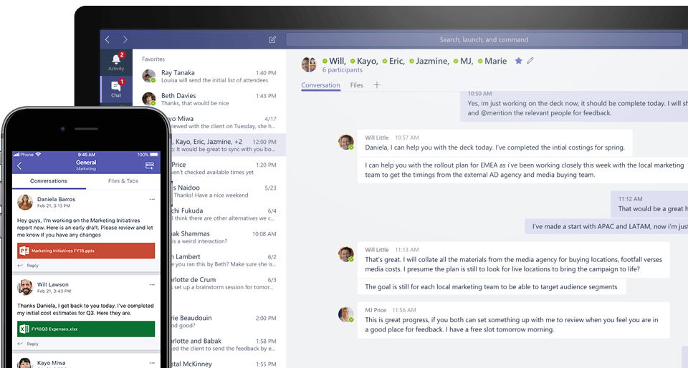


Communication made simple
1:1 or group chat
Speed innovation together using 1:1 and group chat.
Engage in conversations with your peers and clients.
Keep your work organized in teams and channels
Share meeting notes, files, dashboards and apps in the same conversation
Online meetings
Host online meetings with anyone inside or outside your organization using scheduling assistant, screen sharing, and collaborative note taking.​
Be flexible and inclusive in video calls with options to blur or customize backgrounds, real-time closed captions, transcriptions and 49 attendees in Large Gallery View
Calling (available as add-on)¹
Make and receive phone calls
from anywhere with a cloud-based phone system in Teams.
Enjoy cloud calling features like consultative transfer, music-on-hold, cloud voicemail, and more.
Add a dial-in number to your conference calls in case attendees don’t have good internet connection
¹ Enabled with Microsoft 365 Business Voice add-on

Slide 23
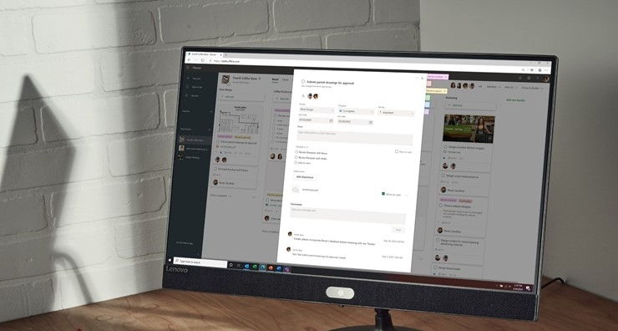
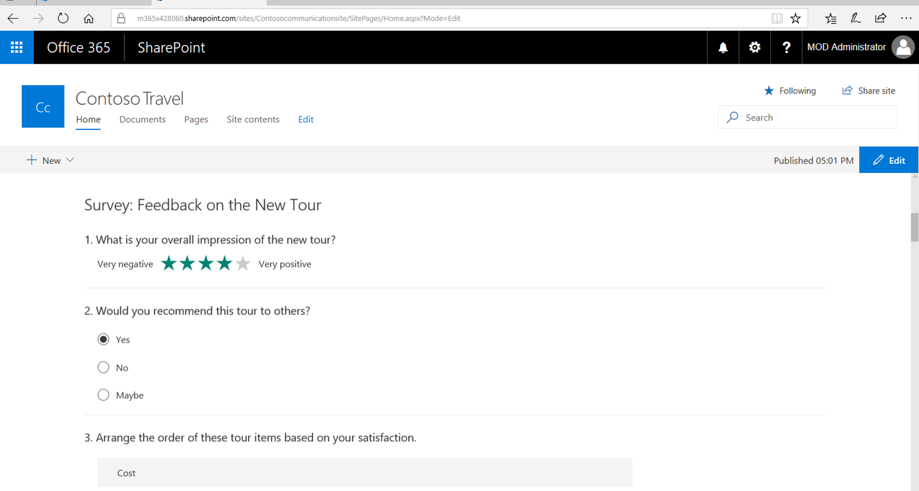

Advanced Collaboration
Sharing Content
Share and manage content, knowledge, and applications with SharePoint
Empower teamwork, quickly find information, and seamlessly collaborate across the organization
Organizing teamwork
Create new plans, drill into existing ones, and understand task progress
Get an overview of multiple projects in one glance
See how many tasks are assigned to each individual team member ​
Discussions and deliverables stay with the plan and don’t get locked away across disparate applications
​
Generating insights
Create surveys, quizzes or polls and send them out in just a few minutes
Gather business insights in real time with automatic charts and easy filtering
Title
benefits

Slide 24
Overcoming Objections
Questions?
Q: “A lot is changing in the market right now. I’m not sure we can afford to start using a new tool.”
A: The changing market landscape has forced many businesses to find solutions that enable them to stay productive while working remotely so there is no better time to find a tool that can help you operate efficiently and securely.
There are many good productivity tools available, but Microsoft 365 offers an integrated solution with the productivity solutions customers need – and the price is potentially lower than the collection of comparable products from other vendors.
Q: “I’m concerned about the subscription-based price compared to the one-time expense I’m used to. I’m not sure I want a monthly subscription or an annual contract.”
A: Microsoft 365 plans are less expensive and easier to manage than a comparable collection of third-party solutions from other vendors, as any Microsoft 365 plan provides an all-in-one solution for collaboration, communication, and security.
In fact, our subscriptions start at $5/user/month (with an annual commitment) with Microsoft 365 Business Basic.
You also get more value from subscription-based cloud services than you do from locally installed software:
• Regular updates with the latest capabilities.
• Billing options both monthly or annually; the subscription fee doesn’t require access to credit.

Slide 25


From Microsoft 365 Business Basic to Microsoft 365 Business Standard
Scenario 2
Exchange
Teams
Sharepoint
Forms
Planner
Power Automate
& Power Apps
OneDrive
Yammer
My Analytics
Stream
Exchange
Teams
Sharepoint
Forms
Planner
Power Automate
& Power Apps
OneDrive
Outlook
Word
Excel
PowerPoint
Publisher
Access
Bookings
Yammer
My Analytics
Stream

Slide 26
Customer Profile
From Microsoft 365 Business Basic…
User Experience
Appointment Scheduling
Limited user experience as Office Web Apps do not employ all functionalities Desktop Apps do
Connecting Outlook Web App with multiple mail accounts or external mail providers not possible
No ability to edit and work on files without Internet, since you are relying on the web applications
Advanced features missing across Excel, Word, PowerPoint and OneNote
You do not have the Publisher and Access applications, as these are desktop only
Organizing external appointments via Mail only
Loosing overview of different scheduling processes, e.g. when setting up job interviews or customer appointments
Difficulties to coordinate multi-participant appointments
May be paying for a third-party booking service without knowing about Microsoft Booking as part of Microsoft 365 Business Standard
Productivity
Unable to do advanced business analysis in Excel (connecting external data sources, Power Pivot, slicers, what-if analysis etc)
Missing advanced collaboration features in Word (track changes, merge etc.) to make it easier to work together on documents
Understand customers spend and use of databases, as they can be created without need for deep developer skills with Access, which you can also connect to LOB business specific apps
Create professional, low-cost publications with Publisher
Mileage Tracking
Manual tracking and reporting of deductible and reimbursable miles driven
Separate subscription to MileIQ or similar mileage-logging services

Slide 27
Additional Value
…to Microsoft 365 Business Standard
 | Personalized, intelligent inbox helps you focus on what matters most – by grouping your most important emails together. Quickly view, edit and share documents even on the go with deep integration of all Office apps. |  | Design and publish customized materials for any purpose.
 | Create, edit and view PivotTables. Draw insights with functions such as New data types, Ideas, and XLOOKUP. |  | Build and share databases in just a few seconds. Run reports and queries to put your data into the format you want. Integrate data between Access and line-of-business apps using the Access connector library.
 | Enhance your content with Editor, Designer, Tap or the Presenter Coach and choose from various, customizable animations. Make use of rich formatting options for texts and shapes. |  | Streamline appointment scheduling and management with an easy to customize tool. Help your staff stay on top of their schedule and avoid double-bookings. An easy to navigate webpage lets your customers find and book appointments around the clock.
 | Add captions, citations and bibliography and get support for advanced collaboration to merge, compare and combine documents. Work more time-efficient with features like Dictation, Researcher and always stay up-to-date with Version History, Shared with Me or While You Were Away feature.
Outlook
Publisher
Excel Desktop
Access
PowerPoint Desktop
Bookings
Word Desktop

Slide 28
Probing Questions
Customer Challenges
Microsoft 365 Business Standard Solutions
Productivity
Currently, you are relying on the web applications of Word, Excel and PowerPoint. Tell me about your experience.
How can your employees collaborate on files without Internet connection (while travelling etc)?
How do you manage customer appointments and bookings?
Tell me a bit about how and for what purposes your employees currently use Excel, PowerPoint, OneNote and Word
Do you manage large amounts of data in Excel?
Tell me about how you work with data and how you rely on databases? (sales, marketing etc)
Do you rely on publishing needs?
Productivity
Improve productivity with the Desktop Apps
Edit files without Internet connection with the Desktop Applications of Word, Excel, OneNote & PowerPoint
More collaboration features in Word, like turning on track changes, merge, compare, and combine documents to make it easier to work together on documents
Enable advanced Excel capabilities to enable in-depth analysis and improved productivity with features such as external data connections, advanced analysis views (Power View, Power Pivot, Slicers), formula tools, what-if analysis, offline viewing and more
Allow customers to schedule time with you via Customer Bookings in a customizable scheduling web page
Create your own database apps easily with Access and connect to business specific apps and create professional, low-cost publications with Publisher
Improve productivity and lower your IT spend by consolidating solutions!
Point solutions are expensive and time consuming to manage. Microsoft 365 is the best of breed and the best platform. Consolidate & save!
Google Workspace Business Starter (equivalent to M365 Business Basic) costs 21% more
Customer booking solutions can be replaced with Bookings
Database related costs can potentially be reduced with Access
Publishing costs can potentially be reduced with Publisher

Slide 29

Expand your possibilities with desktop apps
Improve productivity
More collaboration features in Word and OneNote
Advanced features in PowerPoint and Excel to enrich your presentations and analysis
More Office features
Improve productivity with the Desktop Apps, and install desktop apps on up to 5 PCs/Macs, 5 tablets and 5 mobile devices
Edit files without Internet connection with the Desktop Applications of Word, Excel, OneNote & PowerPoint
Get Access & Publisher
Streamlining appointments
Make use of Bookings app across all organizational levels
Find available time slots quickly with Office calendar integration to ensure staff are not double-booked
Title
benefits

Slide 30


Pricing Comparison
From…
…To
Alternative
Step up and save
M365 Business Standard $12.50
=
M365 Business Basic ($5.00)
+ $13.25
M365 Apps for Business ($8.25)
+
Bookings
+24%
$21.00
~ +70%
$12.50
Competitor prices
Productivity Suites (without desktop apps)
Appointment Scheduling
$5.00
Business Standard $12.00
Premium $9.00
Microsoft 365
Business Basic
Microsoft 365
Business Standard
Competitors

Slide 31

Pricing Comparison
From…
…To
Alternative
Step up and save
$31.00
M365 Business Standard $12.50
=
M365 Business Basic ($5.00)
+ $13.25
M365 Apps for Business ($8.25)
+
Bookings & MileIQ
+24%
~ +150%
$12.50
Competitor prices
Productivity Suites (without desktop apps)
Appointment Scheduling
Milage Tracking
$5.00
Business Standard $12.00
Premium $9.00
Pro $10.00
Microsoft 365
Business Basic
Microsoft 365
Business Standard
Competitors

Slide 32
Overcoming Objections
Question?
Q: “I’m concerned about training and implementation costs.”
A: Office integration enables your workers to use the Office apps that are deeply familiar to many—like Word, Excel, PowerPoint, Outlook, etc. New software makes remote work more available to employees, which is critical for maintaining productivity in the current economic landscape.
Direct customers to https://aka.ms/SmallBusinessHelpAndLearning for additional help and learning resources.

Slide 33
From Microsoft 365 Apps for Business to Microsoft 365 Business Standard
Scenario 3
OneDrive
Outlook
Word
Excel
PowerPoint
Publisher
Access
Stream
Exchange
Teams
Sharepoint
Forms
Planner
Power Automate
& Power Apps
OneDrive
Outlook
Word
Excel
PowerPoint
Publisher
Access
Bookings
& MileIQ
Yammer
My Analytics
Stream

Slide 34
Customer Profile
From Microsoft 365 Apps for Business…
Productivity
Communication
Only includes apps – need to be installed on devices to access and edit files
Access from limited number of devices
May be paying for a third-party mail host without own domain
Uses multiple applications to chat (e.g. Whatsapp) and do videoconferences (e.g. Zoom) – disjointed user experience
Dealing with multiple vendors make it hard to manage applications and keep them secured and control where data & confidential info lives
Receives inbound calls to a fixed landline in an office (impacted business continuity during COVID lockdown)
May be paying for an on-premises PBX (private brunch exchange) to receive calls, rout to different departments and take voicemails. Incurs in hardware and software maintenance costs
Task Management
Customer Insights
Keeps a list of to-dos on paper to organize their day and avoid forgetting important tasks
May use a whiteboard and sticky notes to assign tasks to project members and keep track of progress/completion
Depends on verbal feedback from customers to improve which may not usually happen
May pay for a 3rd party application (e.g. Survey Monkey) to capture customer feedback

Slide 35
Additional Value
…to Microsoft 365 Business Standard
 | Work securely, anywhere, with Microsoft hosted email and calendaring for business |  | Collect data and make better decisions with an easy form to create polls, surveys and quizzes. Built-in AI provides smart recommendations to do the heavy lifting for you. Visualize data in seconds with powerful, real-time charts and automatically generated reports.
 | Chat, Meet, Call and Collaborate in a single app with Video conferencing, Screen sharing, Custom backgrounds, Together mode, File sharing and collaboration, Apps integration, Workflows automation and built-in Privacy & Security. |  | Organize teamwork with intuitive, collaborative, visual task management. Create Kanban boards using content-rich task cards with files, checklists, labels, and more. Collaborate in Planner and Microsoft Teams and check visual status charts—all in the Microsoft cloud.
 | Company intranet packed with intelligent features and available from anywhere. Share and manage content, knowledge, and applications to empower teamwork, quickly find information, and seamlessly collaborate across the organization. |  | Include powerful workflow automation directly in your apps with a no-code approach that connects to hundreds of popular apps and services Build apps in hours -not months- that easily connect to data, use Excel-like expressions to add logic, and run on the web, iOS, and Android devices.
 | Enjoy 1TB storage per user to access and protect your business and school work with this intelligent files app. Share and collaborate from anywhere, on any device. Back up, protect and recover files from accidental deletes or malicious attacks |  | Streamline appointment scheduling and management with an easy to customize tool. Help your staff stay on top of their schedule and avoid double-bookings. An easy to navigate webpage lets your customers find and book appointments around the clock.
Exchange
Forms
Teams
Planner
Sharepoint
Power Automate
& Power Apps
OneDrive
Bookings

Slide 36
Probing Questions
Customer Challenges
Microsoft 365 Business Standard
Productivity
Tell me about how your employees collaborate with each other? What solutions to you use?
How can your employees stay productive outside of the office? Can they access files, chat and collaborate securely across devices?
How do you run customer, partner or employee surveys?
How do customers make appointments with you?
Productivity
Enable a one stop shop for collaboration and sharing through Teams, with channels, groups, chat and calling (Voice add on)
Share, edit, and co-author Word, Excel, and PowerPoint files, all within Microsoft Teams.
Allow customers to schedule time with you via Customer Bookings in a customizable scheduling web page
Meetings
Tell me about how you manage meetings from the set up, to the meeting and the follow up? (scheduling, running engaging and effective online meetings and following up on actions)
How do you run online meetings with external customers or partners? Can you easily adapt your video background with blurred background or a company logo?
Can you make phone calls across devices with Teams and dial into meetings with your phone number (Business Voice add-on required)
Meetings
Host online meetings with anyone inside or outside your organization and look more professional with blurred and custom backgrounds (ex company logo). View up to 49 attendees in the Gallery View
Manage the whole meeting cycle effectively with scheduling assistant, video, screen sharing, whiteboard and shared notes
Use Teams as your Phone and make phone calls across devices with a cloud-based phone system (Business Voice add-on required)
Lower your IT spend by consolidating solutions!
Point solutions are expensive and time consuming to manage (Microsoft 365 is the best of breed and the best platform. Consolidate & save!)
Reduce on-prem infrastructure, hardware, licensing and maintenance costs and move IT spend from CapEx to OpEx with Cloud solutions
Google Workspace Business Starter (equivalent to M365 Business Basic) costs 21% more

Slide 37
Communication made simple
1:1 or group chat
Speed innovation together using 1:1 and group chat.
Engage in conversations with your peers and clients.
Keep your work organized in teams and channels
Share meeting notes, files, dashboards and apps in the same conversation
Online meetings
Host online meetings with anyone inside or outside your organization using scheduling assistant, screen sharing, and collaborative note taking.​
Be flexible and inclusive in video calls with options to blur or customize backgrounds, real-time closed captions, transcriptions and 49 attendees in Large Gallery View
Calling (available as add-on)¹
Make and receive phone calls
from anywhere with a cloud-based phone system in Teams.
Enjoy cloud calling features like consultative transfer, music-on-hold, cloud voicemail, and more.
Add a dial-in number to your conference calls in case attendees don’t have good internet connection
¹ Enabled with Microsoft 365 Business Voice add-on

Slide 38

Enhancing Productivity
Sharing Content
Share and manage content, knowledge, and applications with SharePoint
Empower teamwork, quickly find information, and seamlessly collaborate across the organization
Process Automation
Include powerful workflow automation directly in your apps with a no-code approach that connects to hundreds of popular apps and services
Streamlining appointments
Make use of Bookings app across all organizational levels
Find available time slots quickly with Office calendar integration to ensure staff are not double-booked
Process Automation
Include powerful workflow automation directly in your apps with a no-code approach that connects to hundreds of popular apps and services

Slide 39
Pricing Comparison
From…
…To
Alternative
Step up and save
M365 Business Standard $12.50
=
M365 Business Basic ($5.00)
+ $13.25
M365 Apps for Business ($8.25)
+
Bookings
+24%
$21.00
~ +70%
$12.50
Competitor prices
Productivity Suites (without desktop apps)
Appointment Scheduling
$5.00
Business Standard $12.00
Premium $9.00
Microsoft 365
Business Basic
Microsoft 365
Business Standard
Competitors

Slide 40
Pricing Comparison
From…
…To
Alternative
Step up and save
$31.00
M365 Business Standard $12.50
=
M365 Business Basic ($5.00)
+ $13.25
M365 Apps for Business ($8.25)
+
Bookings & MileIQ
+24%
~ +150%
$12.50
Competitor prices
$8.25
Productivity Suites (without desktop apps)
Appointment Scheduling
Milage Tracking
Business Standard $12.00
Premium $9.00
Pro $10.00
Microsoft 365
Apps for Business
Microsoft 365
Business Standard
Competitors

Slide 41
Overcoming Objections
Questions?
Q: “We are already using a competitor tool/solution, so I’m not sure we would benefit from switching. What makes your solution different, and/or why should I consider switching?”
A: Note: These resources are for the education of the caller only and are NOT to be shared externally or with the customer. Use the below resources to help overcome any compete objections and differentiate Microsoft 365 from other products in the marketplace.
• Security Overcoming Objections (SMB resource)
• Modern Work Compete (all commercial resources)
• Zoom Battlecard (commercial resource)
• Google Battlecard (commercial resource)

Slide 42
From Microsoft 365 Business Standard to Microsoft 365 Business Premium
Scenario 4
Exchange
Teams
Sharepoint
Forms
Planner
Power Automate
& Power Apps
OneDrive
Outlook
Word
Excel
PowerPoint
Publisher
Access
Yammer
My Analytics
Stream
Exchange
Teams
Sharepoint
Forms
Planner
Power Automate
& Power Apps
OneDrive
Outlook
Word
Excel
PowerPoint
Publisher
Access
Yammer
My Analytics
Stream
Endpoint Manager
Information Protection
Conditional Access
Windows Virtual Dsktp
Defender
Antivirus
Defender for O365
Cloud App Security

Slide 43
Customer Profile
From Microsoft 365 Business Standard…
Business Data Handling
Anti Virus Measures
Security measures may be used inconsistently, and files don't travel well - documents are emailed around or saved on USB keys without any protections.
Anyone can download a confidential document and leave the company.​
Unable to delete company data from employees that have used their own device after they quit
Unable to delete company data remotely if a device is lost or stolen
No measures in place to prevent accidental data leaks by employees, which represent 72% of data leaks
Bad actors outside the circle of trust may try to gain access to work information, for example by stealing passwords and trying to gain access to the work data from another country.
May be paying for a 3rd party antivirus, and being unaware that Microsoft Defender Antivirus is included in M365 BP
Device Security & Management
Secure Remote Access
Employees may be using their personal phone to check company emails and save files on it
Hard to control from which devices and users can access business information
Time consuming and complex to manage multiple vendor solutions
Employees may need access to work data as they work from home or on the go – customer may not have a way to allow employees to access work securely (multi factor authentication, conditional access)

Slide 44
Additional Value
…to Microsoft 365 Business Premium
 | Gets endpoint security, device management, and intelligent cloud actions in a unified management platform with Microsoft Intune and Configuration Manager. Helps secure, deploy, and manage all users, apps, and devices without disruption to existing processes. |  | Microsoft Defender Antivirus is the next-generation protection component of Microsoft Defender Advanced Threat Protection (Microsoft Defender ATP). Next-generation protection brings together machine learning, big-data analysis, in-depth threat resistance research, and the Microsoft cloud infrastructure to protect devices in your enterprise organization.
 | Azure Information Protection for Microsoft 365 protects important information from unauthorized access, enforces policies that improve data security, and helps enable secure collaboration. |  | Microsoft Defender for Office 365 safeguards your organization against malicious threats posed by email messages, links (URLs), and collaboration tools.
 | Conditional Access is a capability of Azure Active Directory that enables you to enforce controls on the access to apps in your environment, all based on specific conditions and managed from a central location. |  | Identify and combat cyberthreats across all your cloud services with Microsoft Cloud App Security, a cloud access security broker (CASB) that provides multifunction visibility, control over data travel, and sophisticated analytics.
 | Access Windows 10 desktops on any device, from anywhere. Provide employees the best virtualized experience with the only solution fully optimized for Windows 10 and Office 365 |  | Deploy your devices remotely from any location in minutes with just a few steps and have your employees up and running within minutes after receiving their new device. Secure device protection, save time, reduce cost and improve employee satisfaction with simplified deployment and remote repair capabilities.
Endpoint
Manager
Defender
Antivirus
Information
Protection
Defender for O365
Conditional Access
Cloud App Security
Windows Virtual Desktop
Windows Autopilot

Slide 45
Probing Questions | To be used together with the SMB Workshop Tool
Customer Challenges
Microsoft 365 Business Premium Solutions
Security
Tell me about how your company views security and your current security solutions (ask follow up questions based on answer)
Tell me about your current Email protection (250% increase in phishing email detections from January to December 2018 worldwide)
Do you use IT solutions from various vendors? For example, an antivirus?
What kind of data does your company handle?
Can you prevent employees from accidentally sharing data with external people?
Security
Microsoft uses artificial intelligence to identify and protect against emerging threats in real-time
Protect your business from phishing and Ransomware attempts
Secure log in to your company network (MFA) when employees work from home or travel
Classify and protect sensitive data like customer or employee information, confidential business data, social security numbers and credit card numbers and avoid accidental data leaks
Ensure that only the right people have the right access to work data, whenever and wherever they need
Device Management
How do you currently manage your employee’s devices?
Are you able to support Bring your own device scenarios?
Can you delete company data from an employee-owned device?
Can you delete company data remotely if a device is lost or stolen?
Device Management
Manage devices fast and simply via the Microsoft 365 Business admin console, specifically built for small business customers
Delete company data from a lost or stolen device remotely in a few clicks
Set and adapt company IT policies to help protect your business
Cost
Would you like to do an assessment of your IT needs including cost and ROI? (SMB Workshop Tool – now available in local languages)
Cost
Microsoft 365 is the best of breed and the best platform, and is the only vendor that is a leader across multiple key Gartner quadrants
Microsoft Defender Antivirus consistently top rated, save time and money by removing 3rd party solutions
Remove 3rd party email solutions – Defender for O365 included in BP

Slide 46



Advanced Security Capabilities ​
Secure Devices
​Control which devices and users can access business information with Intune Device Management.
Apply security policies to protect data on any devices.
Remove business data from lost or stolen devices with Intune selective wipe.​​
Protect Business Data
​Encrypt sensitive emails.
Block sharing of sensitive information like credit card numbers with Azure Information Protection.
Restrict copying and saving of business information. Enable unlimited cloud archiving.​​
Enhanced Antivirus
Enforce malware protection across Windows 10 devices with Windows Defender, now with management capabilities to give you visibility into active threats in your environment. ​

Slide 47


Advanced Security Capabilities ​
Defense against cyber threats
Guard against unsafe attachments, suspicious links, phishing and ransomware with ATP Safe Links.
Detect malware with sandbox analysis of email attachments with ATP Safe Attachments.
Enable advanced multi-factor authentication. ​
Enable secure remote access
Enable employees to securely access business apps, wherever they work.
Help protect against lost or stolen passwords with advanced multi-factor authentication.
Provide the right access to the right people, while keeping hackers at bay.​
Enhanced Antivirus
benefits

Slide 48

Pricing Comparison
From…
…To
Competition
Competitor prices
Productivity Suites (without desktop apps)
Chat-based collaboration
>$40.00
Business Standard $12.00
$6.67
+ 100%
Security, Identity and Device Management¹
Remote access solutions $5.00
Advanced Email protection $5.00
Single Sign-On $2.00
Conditional Access+ MFA $6.00
Endpoint anti-virus protection $3.00
Device management $4.00
$20.00
$12.50
¹ Estimates based on published prices
Single Sign On– Okta $2; Adaptive MFA (Conditional Access+ MFA) – Okta $6
Device Management - IBM MaaS 360- $4.00, Endpoint Protection – Kaspersky - $3.38, Proofpoint email protection - $5
Remote Access: Windows Terminal server CAL ($199 perpetual per user; over 3 years – per month would be around $5); TeamViewer - $49 per user per month
Microsoft 365
Business Standard
Microsoft 365
Business Premium
3rd party solutions

Slide 49
Overcoming Objections
Questions?
Q: “I’m not sure that the costs of a security breach warrant the expense of new software.”
A: Research shows that the average cost of a security attack for small businesses is around $149,000.¹ That is a significant financial impact. Another concern is that 50% of small businesses have experienced an attack in the last year.²
It’s certainly understandable to be wary of new expenses, especially now, but the cost of a cyberattack or data breach can far outweigh the additional expense of the robust security features included in Microsoft 365 Business Premium.
Q: “I’m concerned about training and implementation costs.”
A: Office integration enables your workers to use the Office apps that are deeply familiar to many—like Word, Excel, PowerPoint, Outlook, etc. New software makes remote work more available to employees, which is critical for maintaining productivity in the current economic landscape.
Microsoft 365 brings together videoconferencing, chat, file storage, and document editing all in one place with Microsoft Teams – which makes training easier when compared to using separate applications from different vendors.
¹ US and Canada avg recovery costs, Kaspersky Lab Report
² 2018 7 Microsoft commissioned Forrester Research, 2020

Slide 50
Microsoft 365 for Enterprise

Slide 51
Microsoft 365 Portfolios
Start by identifying what type of customer you are talking to
Consumer
For Home
Microsoft 365 Personal
Microsoft 365 Family
Microsoft 365 Business Basic
Microsoft 365 Business Standard
Microsoft 365 Business Premium
SMB (<300)
For Business
Office 365 E1
Office 365 E3 / EMS E3 / Windows E3
Office 365 E5 / EMS E5 / Windows E5
Microsoft 365 E3
Microsoft 365 E5
Microsoft 365 F1
Microsoft 365 F3
Enterprise (>300)
For Enterprise
Frontline
Microsoft 365 A1
Microsoft 365 A3
Microsoft 365 A5
Academic
For Education

Slide 52




Upsell Scenarios | Enterprise SKU Summary
Exchange
Teams
Sharepoint
Forms
Power Automate
& Power Apps
Defender
Antivirus
Email
Planner
OneDrive
Yammer & Delve
Outlook
Word
Excel
PowerPoint
Publisher
Access
Bookings
Endpoint Manager
Information Protection
Conditional Access
Windows Virtual Dsktp
Data classification
O365 E1
O365 E3
M365 E3
Microsoft Defender
Cloud App Security
Risk based conditional access
Advanced Information Protection
Risk management
Advanced identity management
Advanced threat analytics and remediation
M365 E5
Information governance
Advanced access & entitlement management
Advanced data classification
Power BI
Cloud based phone system
Audio conferencing
From: Exchange Online ($4) | From: O365 E1($8) | From: O365 E3 ($20) | From: M365 E3 ($32)
Create a hub for teamwork to connect with your teams and customers via chat, call or videoconference and collaborate. Access web versions of Office apps: Outlook, Word, Excel, PowerPoint, OneNote. Store and share files with 1 TB of file storage in the cloud per user. Co-author files in real time, auto-save to avoid losing progress, keep backups and recover old versions when needed. Create simple forms, surveys and polls Manage tasks (personal/groups) and stay on track with Planner and its Teams integration Automate processes, develop apps without the need of coding skills | AI-infused desktop apps connected to cloud services. Always up-to-date. Install in up to 5 PCs/Macs, 5 tablets and 5 mobile devices concurrently Make amazing content with Editor, Designer, Tap, Presenter Coach Get work done faster with Dictation, Researcher, Insert Data from Picture Work together across apps with real-time Co-authoring, @mentions and Teams-Office apps integration Keep current always with Version History, Shared with Me, While You Were Away Draw visualized insights with New data types, Ideas, XLOOKUP Streamline appointment scheduling and automatically track milage as you drive Find and share information using Delve and Yammer | Protect your business with core security and management capabilities. Protect against cyberthreats and control access to sensitive information using encryption, Conditional Access, Windows Hello and self-password reset. Protect data from accidental or intentional leaks by restricting copy/paste/forward, Data Loss Prevention policies Manage devices and applications effectively with Endpoint Manager through MDM/MAM. Secure devices that connect to your data and help keep iOS, Android, Windows, and Mac devices safe and up to date, remote wiping lost/stolen devices Simplify deployment by enabling remote deployment with Windows Autopilot. Get visibility and manage risk of cloud apps being used across your organisation to prevent shadow IT Provide remote access to secure Virtual Windows Desktop environments | Protect, detect, and automatically respond to advanced and sophisticated threats by leveraging the power of machine learning and built-in integration across endpoints, mail, files, and identities. Protect with sophisticated encryption, malware, phishing, ransomware and Cloud app protection. Control access to sensitive information using risk based Conditional Access and advanced identity protection. Protect from accidental or intentional data leaks with automatically applied sensitivity labels. Help comply with regulations such as GDPR with advanced compliance functionality. Effectively manage risk by detecting, investigating and acting on security and compliance issues such as breaches, confidentiality violations, fraud, IP theft and more. Improve communication with Cloud Telephony by enriching Teams with advanced calling capabilities. Get answers to key business questions when and where you need it with Business Intelligence.
To: O365 E1 ($8) | To: O365 E3 ($20) | To: M365 E3 ($32) | To: M365 E5 ($57)

Slide 53
Enterprise Portfolio Upsell Framework
Based on Land & Expand (LXP)
 | Microsoft 365 E3 + E5 Security | Microsoft 365 E5
AAD or EMS E3 | Microsoft 365 E3 | Microsoft 365 E3 + E5 Teams Voice
On-Prem or Exchange Online / O365 E1 | Office 365 E3 | Office 365 E3 + E5 Teams Voice
3B
3C
Advanced Security (EMS E5)
Surface
Surface + MS Teams devices
2A
2B
2C
Security Upsell →
Basic
Security
(AAD/EMS E3)
Surface
MS Teams devices
1A
1B
1C
No Security
MS Teams devices
No Teams
Teams (O365)
Teams + Voice
Teams Upsell →

Slide 54
Virtuous Upsell Framework | Sales Plays & Partner Motion | V2
UK SMB-TU ABM 4,883 TPIDs (Q3 FY21) | ME3+E5 Security or components 1% ~41 TPIDs: Goal: Convert to ME5 Sales Play: Teams Meetings & Callings (Upsell) Compliance (Upsell) Surface (Expansion) Partner Workshop: Compliance (Upsell) Teams Callings (Upsell) Teams Meetings (Usage) Security Workshop (Usage) | ME5 1% ~46 TPIDs Goal: Expand ME5 and Firstline Sales Play: Surface (Acquisition) Firstline (Expansion) Teams Platform (Usage) Knowledge & Insights (WPA) Partner Workshop: Security (Security ACR) Teams Callings/Meetings (Usage) Security Workshop (Usage)
EMS E3 or AADP1, or no Teams 37% ~1792 TPIDs Goal: Convert to ME3 Sales Play: Secure Remote Work Partner Workshop: Secure Remote Work (E3 Upsell) Identity (Usage) Solution Assessments: Teams Assessment | ME3, no E5 security or components 3% ~139 TPIDs Goal: Upsell to E5 via security vendor consolidation Sales Play: Security (Upsell) Surface (Acquistion) Partner Workshop: Security (E5 Upsell) Teams Callings (E5 Upsell) Teams Meetings (Usage) Identity (Usage) | ME3 + E5 Voice (Audio Conf or Phone System) 2% ~73 TPIDs Goal: Convert to ME5 Sales Play: Security (Upsell) Surface (Acquisition) Partner Workshop: Security (E5 Upsell) Teams Meetings/Callings (Usage) Identity (Usage)
No cloud licenses; on-prem 45% ~2189 TPIDs Goal: Convert new trials to paid O365/M365 Sales Play: Secure Remote Work (Acquisition/Usage) Partner Workshop: Secure Remote Work (E3 Upsell) Solution Assessments: Workplace Modernization Assessment | O365, no Security 12% ~578 TPIDs Goal: Add EMS to Teams for secure remote work, add Teams premium workloads (e.g., audio conferencing) Sales Plays: Security (Upsell) Secure Remote Work (Usage) Partner Workshop: Endpoint Manager (Upsell) Secure Remote Work (Usage) Teams Meetings (Usage) Solution Assessments: Cybersecurity Assessment | OE3 + E5 Voice (Audio Conf or Phone System) 1% ~25 TPIDs Goal: Convert to ME3 Sales Plays: Security (Upsell) Secure Remote Work (Usage) Partner Workshop: Security (E5 Upsell) Teams Meetings/Callings (Usage)
3B
3C
ME5 or
E5 security components
2A
2B
2C
Security
ME3 or E3
1A
1B
1C
No Security licenses
No Teams licenses
ME3 or E3
ME5 or E5 Voice (Audio Conf, Phone System)
Teams

Slide 55





Scenarios Menu | Enterprise SKUs
Click to drill down

Slide 56
From Exchange Online to Office 365 E1
Scenario 1
Exchange
Exchange
Teams
Sharepoint
Forms
Planner
Power Automate
& Power Apps
OneDrive
Office Web Versions
Yammer & Delve
Stream
My Analytics

Slide 57
Customer Profile
From Exchange Online…
Productivity
Communication
On-premises file storage that requires access to office network. Files are hard to find
May be paying for a 3rd Party cloud storage app (e.g. Dropbox) and not know about OneDrive
Shares documents as email attachments and must wait for recipient to make edits and send it back. May need to pay extra for increased inbox capacity
Users occasionally loose information as they forget to save progress when working on files
Uses multiple applications to chat (e.g. Whatsapp) and do videoconferences (e.g. Zoom) – disjointed user experience
Dealing with multiple vendors make it hard to manage applications and keep them secured and control where data & confidential info lives
Receives inbound calls to a fixed landline in an office (impacted business continuity during COVID lockdown)
May be paying for an on-premises PBX (private brunch exchange) to receive calls, rout to different departments and take voicemails. Incurs in hardware and software maintenance costs
Task Management
Customer Insights
Keeps a list of to-dos on paper to organize their day and avoid forgetting important tasks
May use a whiteboard and sticky notes to assign tasks to project members and keep track of progress/completion
Depends on verbal feedback from customers to improve which may not usually happen
May pay for a 3rd party application (e.g. Survey Monkey) to capture customer feedback

Slide 58
Additional Value
…to Office 365 E1
 | Chat, Meet, Call and Collaborate in a single app with Video conferencing, Screen sharing, Custom backgrounds, Together mode, File sharing and collaboration, Apps integration, Workflows automation and built-in Privacy & Security. |  | Collect data and make better decisions with an easy form to create polls, surveys and quizzes. Built-in AI provides smart recommendations to do the heavy lifting for you. Visualize data in seconds with powerful, real-time charts and automatically generated reports.
 | Company intranet packed with intelligent features and available from anywhere. Share and manage content, knowledge, and applications to empower teamwork, quickly find information, and seamlessly collaborate across the organization. |  | Organize teamwork with intuitive, collaborative, visual task management. Create Kanban boards using content-rich task cards with files, checklists, labels, and more. Collaborate in Planner and Microsoft Teams and check visual status charts—all in the Microsoft cloud.
 | Enjoy 1TB storage per user to access and protect your business and schoolwork with this intelligent files app. Share and collaborate from anywhere, on any device. Back up, protect and recover files from accidental deletes or malicious attacks |  | Include powerful workflow automation directly in your apps with a no-code approach that connects to hundreds of popular apps and services Build apps in hours -not months- that easily connect to data, use Excel-like expressions to add logic, and run on the web, iOS, and Android devices.
 | Access Word, Excel and PowerPoint from anywhere on your favourite browser. Enjoy the familiar Office experience you know and trust. Share your documents with anyone and work together in real-time |  | Connect and engage across your company with Yammer as your internal social network and deliver live and on-demand events. Use Delve to discover and organize the information that is most relevant to you.
Teams
Forms
Sharepoint
Planner
OneDrive
Power Automate
& Power Apps
Web versions of
Word, Excel, PPT
Yammer & Delve

Slide 59
Probing Questions
Customer Challenges
Office 365 E1 Solutions
Productivity
How can your employees stay productive outside of the office? Can they access files and collaborate securely?
How do your employees share and co-author files? Do they have to send files back and forth? What happens if the file owner is away?
How do you run customer, partner or employee surveys?
Productivity
Enable a central repository so team members can access and view files in a single place from anywhere
Share, edit, and co-author Word, Excel, and PowerPoint files, all within Microsoft Teams.
Provide intelligent email and calendaring capabilities available on any device and run surveys easily with Forms.
Meetings
Tell me about how you manage meetings from the set up, to the meeting and the follow up? (scheduling, running engaging and effective online meetings and following up on actions)
How do you run online meetings with external customers or partners? Can you easily adapt your video background with blurred background or a company logo?
Can you make phone calls across devices with Teams and dial into meetings with your phone number (Phone System add-on required)
Meetings
Host online meetings with anyone inside or outside your organization and look more professional with blurred and custom backgrounds (ex company logo). View up to 49 attendees in the Gallery View
Manage the whole meeting cycle effectively with scheduling assistant, video, screen sharing, whiteboard and shared notes
Use Teams as your Phone and make phone calls across devices with a cloud-based phone system (Phone System add-on required)
Lower your IT spend by consolidating solutions!
Point solutions are expensive and time consuming to manage (Microsoft 365 is the best of breed and the best platform. Consolidate & save!)
Reduce on-prem infrastructure, hardware, licensing and maintenance costs and move IT spend from CapEx to OpEx with Cloud solutions
Google Workspace Business Starter (equivalent to M365 Business Basic) costs 21% more

Slide 60
Enhancing Productivity
File storage and sharing
Save files in the cloud, access them from anywhere and share with confidence.
Keep a single version of the file, share them with links instead of attachments and restore old versions with a single click
Productivity Apps (web)
Get the web versions of the familiar Office apps like Word, Excel, and PowerPoint
Collaborate in real-time with others on documents directly from your browser
Process Automation
Include powerful workflow automation directly in your apps with a no-code approach that connects to hundreds of popular apps and services

Slide 61
Communication made simple
1:1 or group chat
Speed innovation together using 1:1 and group chat.
Engage in conversations with your peers and clients.
Keep your work organized in teams and channels
Share meeting notes, files, dashboards and apps in the same conversation
Online meetings
Host online meetings with anyone inside or outside your organization using scheduling assistant, screen sharing, and collaborative note taking.​
Be flexible and inclusive in video calls with options to blur or customize backgrounds, real-time closed captions, transcriptions and 49 attendees in Large Gallery View
Calling (available as add-on)¹
Make and receive phone calls
from anywhere with a cloud-based phone system in Teams.
Enjoy cloud calling features like consultative transfer, music-on-hold, cloud voicemail, and more.
Add a dial-in number to your conference calls in case attendees don’t have good internet connection
¹ Enabled with Microsoft 365 Business Voice add-on

Slide 62
Advanced Collaboration
Sharing Content
Share and manage content, knowledge, and applications with SharePoint
Empower teamwork, quickly find information, and seamlessly collaborate across the organization
Organizing teamwork
Create new plans, drill into existing ones, and understand task progress
Get an overview of multiple projects in one glance
See how many tasks are assigned to each individual team member ​
Discussions and deliverables stay with the plan and don’t get locked away across disparate applications
​
Generating insights
Create surveys, quizzes or polls and send them out in just a few minutes
Gather business insights in real time with automatic charts and easy filtering
Title
benefits

Slide 63
Overcoming Objections
Questions?
Q: “A lot is changing in the market right now. I’m not sure we can afford to start using a new tool.”
A: The changing market landscape has forced many businesses to find solutions that enable them to stay productive while working remotely so there is no better time to find a tool that can help you operate efficiently and securely.
There are many good productivity tools available, but Microsoft 365 offers an integrated solution with the productivity solutions customers need – and the price is potentially lower than the collection of comparable products from other vendors.
Q: “I’m concerned about the subscription-based price compared to the one-time expense I’m used to. I’m not sure I want a monthly subscription or an annual contract.”
A: Microsoft 365 plans are less expensive and easier to manage than a comparable collection of third-party solutions from other vendors, as any Microsoft 365 plan provides an all-in-one solution for collaboration, communication, and security.
In fact, our subscriptions start at $5/user/month (with an annual commitment) with Microsoft 365 Business Basic.
You also get more value from subscription-based cloud services than you do from locally installed software:
• Regular updates with the latest capabilities.
• Billing options both monthly or annually; the subscription fee doesn’t require access to credit.

Slide 64
From Exchange Online to Office 365 E3
Scenario 2
Exchange
Exchange
Teams
Sharepoint
Forms
Planner
Power Automate
& Power Apps
OneDrive
Outlook
Word
Excel
PowerPoint
Publisher
Access
Bookings
Yammer & Delve
Stream
My Analytics

Slide 65
Customer Profile
From Exchange Online…
Productivity
Communication
On-premises file storage that requires access to office network. Files are hard to find
May be paying for a 3rd Party cloud storage app (e.g. Dropbox) and not know about OneDrive
Shares documents as email attachments and must wait for recipient to make edits and send it back. May need to pay extra for increased inbox capacity
Users occasionally loose information as they forget to save progress when working on files
Uses multiple applications to chat (e.g. Whatsapp) and do videoconferences (e.g. Zoom) – disjointed user experience
Dealing with multiple vendors make it hard to manage applications and keep them secured and control where data & confidential info lives
Receives inbound calls to a fixed landline in an office (impacted business continuity during COVID lockdown)
May be paying for an on-premises PBX (private brunch exchange) to receive calls, rout to different departments and take voicemails. Incurs in hardware and software maintenance costs
Task Management
Customer Insights
Keeps a list of to-dos on paper to organize their day and avoid forgetting important tasks
May use a whiteboard and sticky notes to assign tasks to project members and keep track of progress/completion
Depends on verbal feedback from customers to improve which may not usually happen
May pay for a 3rd party application (e.g. Survey Monkey) to capture customer feedback

Slide 66
Additional Value
…to Office 365 E3
 | Chat, Meet, Call and Collaborate in a single app with Video conferencing, Screen sharing, Custom backgrounds, Together mode, File sharing and collaboration, Apps integration, Workflows automation and built-in Privacy & Security. |  | Collect data and make better decisions with an easy form to create polls, surveys and quizzes. Built-in AI provides smart recommendations to do the heavy lifting for you. Visualize data in seconds with powerful, real-time charts and automatically generated reports.
 | Company intranet packed with intelligent features and available from anywhere. Share and manage content, knowledge, and applications to empower teamwork, quickly find information, and seamlessly collaborate across the organization. |  | Organize teamwork with intuitive, collaborative, visual task management. Create Kanban boards using content-rich task cards with files, checklists, labels, and more. Collaborate in Planner and Microsoft Teams and check visual status charts—all in the Microsoft cloud.
 | Enjoy 1TB storage per user to access and protect your business and school work with this intelligent files app. Share and collaborate from anywhere, on any device. Back up, protect and recover files from accidental deletes or malicious attacks |  | Include powerful workflow automation directly in your apps with a no-code approach that connects to hundreds of popular apps and services Build apps in hours -not months- that easily connect to data, use Excel-like expressions to add logic, and run on the web, iOS, and Android devices.
 | Access your favourite Office Apps (Outlook, Word, Excel and PowerPoint) on PC also when offline and from anywhere on your favourite browser. Enjoy the familiar Office experience you know and trust. Share your documents with anyone and work together in real-time |  | Streamline appointment scheduling and management with an easy to customize tool. Accurately track and report mileage in the palm of your hand.
Teams
Forms
Sharepoint
Planner
OneDrive
Power Automate
& Power Apps
Office Desktop App + Web Apps
Bookings

Slide 67
Probing Questions
Customer Challenges
Office 365 E3 Solutions
Productivity
How can your employees stay productive outside of the office? Can they access files and collaborate securely?
How do your employees share and co-author files? Do they have to send files back and forth? What happens if the file owner is away?
How do you run customer, partner or employee surveys?
Productivity
Enable a central repository so team members can access and view files in a single place from anywhere
Full desktop versions to share, edit, co-author and use advanced functionality within Word, Excel, and PowerPoint files.
Intelligent email and calendaring capabilities available on any device and run surveys easily with Forms.
Meetings
Tell me about how you manage meetings from the set up, to the meeting and the follow up? (scheduling, running engaging and effective online meetings and following up on actions)
How do you run online meetings with external customers or partners? Can you easily adapt your video background with blurred background or a company logo?
Can you make phone calls across devices with Teams and dial into meetings with your phone number (Phone System add-on required)
Meetings
Host online meetings with anyone inside or outside your organization and look more professional with blurred and custom backgrounds (ex company logo). View up to 49 attendees in the Gallery View
Manage the whole meeting cycle effectively with scheduling assistant, video, screen sharing, whiteboard and shared notes
Use Teams as your Phone and make phone calls across devices with a cloud-based phone system (Phone System add-on required)
Lower your IT spend by consolidating solutions!
Point solutions are expensive and time consuming to manage (Microsoft 365 is the best of breed and the best platform. Consolidate & save!)
Reduce on-prem infrastructure, hardware, licensing and maintenance costs and move IT spend from CapEx to OpEx with Cloud solutions
Google Workspace Business Starter (equivalent to M365 Business Basic) costs 21% more

Slide 68
Enhancing Productivity
File storage and sharing
Save files in the cloud, access them from anywhere and share with confidence.
Keep a single version of the file, share them with links instead of attachments and restore old versions with a single click
Productivity Apps
Get the both desktop and web versions of the familiar Office apps like Word, Excel, and PowerPoint
Collaborate in real-time with others on documents directly from your browser
Process Automation
Include powerful workflow automation directly in your apps with a no-code approach that connects to hundreds of popular apps and services

Slide 69
Communication made simple
1:1 or group chat
Speed innovation together using 1:1 and group chat.
Engage in conversations with your peers and clients.
Keep your work organized in teams and channels
Share meeting notes, files, dashboards and apps in the same conversation
Online meetings
Host online meetings with anyone inside or outside your organization using scheduling assistant, screen sharing, and collaborative note taking.​
Be flexible and inclusive in video calls with options to blur or customize backgrounds, real-time closed captions, transcriptions and 49 attendees in Large Gallery View
Calling (available as add-on)¹
Make and receive phone calls
from anywhere with a cloud-based phone system in Teams.
Enjoy cloud calling features like consultative transfer, music-on-hold, cloud voicemail, and more.
Add a dial-in number to your conference calls in case attendees don’t have good internet connection
¹ Enabled with Microsoft 365 Business Voice add-on

Slide 70
Advanced Collaboration
Sharing Content
Share and manage content, knowledge, and applications with SharePoint
Empower teamwork, quickly find information, and seamlessly collaborate across the organization
Organizing teamwork
Create new plans, drill into existing ones, and understand task progress
Get an overview of multiple projects in one glance
See how many tasks are assigned to each individual team member ​
Discussions and deliverables stay with the plan and don’t get locked away across disparate applications
​
Generating insights
Create surveys, quizzes or polls and send them out in just a few minutes
Gather business insights in real time with automatic charts and easy filtering
Title
benefits

Slide 71
Overcoming Objections
Questions?
Q: “A lot is changing in the market right now. I’m not sure we can afford to start using a new tool.”
A: The changing market landscape has forced many businesses to find solutions that enable them to stay productive while working remotely so there is no better time to find a tool that can help you operate efficiently and securely.
There are many good productivity tools available, but Microsoft 365 offers an integrated solution with the productivity solutions customers need – and the price is potentially lower than the collection of comparable products from other vendors.
Q: “I’m concerned about the subscription-based price compared to the one-time expense I’m used to. I’m not sure I want a monthly subscription or an annual contract.”
A: Microsoft 365 plans are less expensive and easier to manage than a comparable collection of third-party solutions from other vendors, as any Microsoft 365 plan provides an all-in-one solution for collaboration, communication, and security.
In fact, our subscriptions start at $5/user/month (with an annual commitment) with Microsoft 365 Business Basic.
You also get more value from subscription-based cloud services than you do from locally installed software:
• Regular updates with the latest capabilities.
• Billing options both monthly or annually; the subscription fee doesn’t require access to credit.

Slide 72
From Office 365 E1 to Office 365 E3
Scenario 3
Exchange
Teams
Sharepoint
Forms
Planner
Power Automate
& Power Apps
OneDrive
Office Web Versions
Yammer & Delve
Stream
My Analytics
Exchange
Teams
Sharepoint
Forms
Planner
Power Automate
& Power Apps
OneDrive
Outlook
Word
Excel
PowerPoint
Publisher
Access
Bookings
Yammer & Delve
Stream
My Analytics

Slide 73
Customer Profile
From Office 365 E1…
User Experience
Appointment Scheduling
Limited user experience as Office Web Apps do not employ all functionalities Desktop Apps do
Connecting Outlook Web App with multiple mail accounts or external mail providers not possible
No ability to edit and work on files without Internet, since you are relying on the web applications
Advanced features missing across Excel, Word, PowerPoint and OneNote
You do not have the Publisher and Access applications, as these are desktop only
Organizing external appointments via Mail only
Loosing overview of different scheduling processes, e.g. when setting up job interviews or customer appointments
Difficulties to coordinate multi-participant appointments
May be paying for a third-party booking service without knowing about Microsoft Booking as part of Microsoft 365 Business Standard
Productivity
Unable to do advanced business analysis in Excel (connecting external data sources, Power Pivot, slicers, what-if analysis etc)
Missing advanced collaboration features in Word (track changes, merge etc.) to make it easier to work together on documents
Understand customers spend and use of databases, as they can be created without need for deep developer skills with Access, which you can also connect to LOB business specific apps
Create professional, low-cost publications with Publisher
Mileage Tracking
Manual tracking and reporting of deductible and reimbursable miles driven
Separate subscription to MileIQ or similar mileage-logging services

Slide 74
Additional Value
…to Office 365 E3
 | Personalized, intelligent inbox helps you focus on what matters most – by grouping your most important emails together. Quickly view, edit and share documents even on the go with deep integration of all Office apps. |  | Design and publish customized materials for any purpose.
 | Create, edit and view PivotTables. Draw insights with functions such as New data types, Ideas, and XLOOKUP. |  | Build and share databases in just a few seconds. Run reports and queries to put your data into the format you want. Integrate data between Access and line-of-business apps using the Access connector library.
 | Enhance your content with Editor, Designer, Tap or the Presenter Coach and choose from various, customizable animations. Make use of rich formatting options for texts and shapes. |  | Streamline appointment scheduling and management with an easy to customize tool. Help your staff stay on top of their schedule and avoid double-bookings. An easy to navigate webpage lets your customers find and book appointments around the clock.
 | Add captions, citations and bibliography and get support for advanced collaboration to merge, compare and combine documents. Work more time-efficient with features like Dictation, Researcher and always stay up-to-date with Version History, Shared with Me or While You Were Away feature.
Outlook
Publisher
Excel Desktop
Access
PowerPoint Desktop
Bookings
Word Desktop

Slide 75
Probing Questions
Customer Challenges
Office 365 E3 Solutions
Productivity
Currently, you are relying on the web applications of Word, Excel and PowerPoint. Tell me about your experience.
How can your employees collaborate on files without Internet connection (while travelling etc)?
How do you manage customer appointments and bookings?
Tell me a bit about how and for what purposes your employees currently use Excel, PowerPoint, OneNote and Word
Do you manage large amounts of data in Excel?
Tell me about how you work with data and how you rely on databases? (sales, marketing etc)
Do you rely on publishing needs?
Productivity
Improve productivity with the Desktop Apps
Edit files without Internet connection with the Desktop Applications of Word, Excel, OneNote & PowerPoint
More collaboration features in Word, like turning on track changes, merge, compare, and combine documents to make it easier to work together on documents
Enable advanced Excel capabilities to enable in-depth analysis and improved productivity with features such as external data connections, advanced analysis views (Power View, Power Pivot, Slicers), formula tools, what-if analysis, offline viewing and more
Allow customers to schedule time with you via Customer Bookings in a customizable scheduling web page
Create your own database apps easily with Access and connect to business specific apps and create professional, low-cost publications with Publisher
Improve productivity and lower your IT spend by consolidating solutions!
Point solutions are expensive and time consuming to manage. Microsoft 365 is the best of breed and the best platform. Consolidate & save!
Google Workspace Business Starter (equivalent to M365 Business Basic / O365 E1) costs 21% more
Customer booking solutions can be replaced with Bookings
Database related costs can potentially be reduced with Access
Publishing costs can potentially be reduced with Publisher

Slide 76

Expand your possibilities with desktop apps
More Office features
Install desktop apps on up to 5 PCs/Macs, 5 tablets and 5 mobile devices
Create content more easily with Editor, Designer, Tap or Presenter Coach
Work more time-efficient with Dictation, Researcher, Insert Data from Picture
Streamlining appointments
Make use of Bookings app across all organizational levels
Find available time slots quickly with Office calendar integration to ensure staff are not double-booked
Easy milage tracking
Track miles automatically with MileIQ running in the background
Classify drives (private/business) easily
Generate accurate mileage reports

Slide 77
Pricing Comparison
From…
…To
Alternative
Step up and save
$31.00
Office 365 E3
=
Office 365 E1 ($8.00)
+ $20.00
Microsoft 365 Apps
for Enterprise ($12.00)
+
Bookings & MileIQ
+24%
+55%
$20.00
Competitor prices
Productivity Suites (without desktop apps)
Appointment Scheduling
Milage Tracking
$8.00
Business Standard $12.00
Premium $9.00
Pro $10.00
Office 365 E1
Office 365 E3
Competitors
(without desktop apps)

Slide 78
Overcoming Objections
Question?
Q: “I’m concerned about training and implementation costs.”
A: Office integration enables your workers to use the Office apps that are deeply familiar to many—like Word, Excel, PowerPoint, Outlook, etc. New software makes remote work more available to employees, which is critical for maintaining productivity in the current economic landscape.
Direct customers to https://aka.ms/SmallBusinessHelpAndLearning for additional help and learning resources.

Slide 79

From Office 365 E3 to Microsoft 365 E3
Scenario 4
Exchange
Teams
Sharepoint
Forms
Planner
Power Automate
& Power Apps
OneDrive
Outlook
Word
Excel
PowerPoint
Publisher
Access
Yammer & Delve
My Analytics
Stream
Bookings
Exchange
Teams
Sharepoint
Forms
Planner
Power Automate
& Power Apps
OneDrive
Outlook
Word
Excel
PowerPoint
Publisher
Access
Yammer & Delve
My Analytics
Stream
Bookings
Windows 10 Enterprise
Endpoint Manager
Information Protection
Conditional Access
Windows Virtual Dsktp
Defender
Antivirus
Data classification

Slide 80
Customer Profile
From Office 365 E3…
User Experience
Anti Virus Measures
Customer has collaboration and productivity capabilities with Microsoft Teams and the Office Desktop Apps
The built in Mobile Device Management in O365 does not include App management and Windows Autopilot capabilities, and lacks the in-depth analytics and management functionality that Endpoint Manager provides
The customer lacks capabilities to protect from threats, information leaks and capability to control access to company data. As a result, the customer is not fully equipped to work securely remote
Bad actors outside the circle of trust may try to gain access to work information, for example by stealing passwords and trying to gain access to the work data from another country.
Business Data Handling
Security measures may be used inconsistently, and files don't travel well - documents are emailed around or saved on USB keys without any protections.
Anyone can download a confidential document and leave the company.​
Device Security
Secure Remote Access
Employees may be using their personal phone to check company emails and save files on it
Hard to control from which devices and users can access business information
Logon passwords and other credentials can be easily stolen with Pass-the-Hash or Pass-The-Ticket attacks
Browsing to untrusted sites could expose enterprise data to attackers
Employees may need access to work data as they work from home or on the go.
Bad actors outside the circle of trust may try to gain access to work information, for example by stealing passwords and trying to gain access to the work data from another country.
MAM/MDM not fully enabled; customer may be using the built in O365 MDM tool with limited functionality or 3rd party solutions, which increases complexity and cost

Slide 81



Additional Value
…to Microsoft 365 E3
 | Get a comprehensive identity and access management cloud solution that combines core directory services, application access management, and advanced identity protection |  | Windows 10 Enterprise E3 addresses the needs of large and midsize organizations, providing IT professionals with intelligent security, simplified updates, comprehensive device and app management, longer servicing for September targeted releases, access to LTSC edition, access to MDOP* and Fasttrack support for deployment and app compatibility.
 | Gets endpoint security, device management, and intelligent cloud actions in a unified management platform with Microsoft Intune and Configuration Manager. Helps secure, deploy, and manage all users, apps, and devices without disruption to existing processes. |  | Windows Defender Credential Guard uses virtualization-based security to isolate secrets so that only privileged system software can access them. Unauthorized access to these secrets can lead to credential theft attacks, such as Pass-the-Hash or Pass-The-Ticket. Windows Defender Credential Guard prevents these attacks.
 | Azure Information Protection for Microsoft 365 protects important information from unauthorized access, enforces policies that improve data security, and helps enable secure collaboration. |  | Microsoft Defender Application Guard helps to isolate enterprise-defined untrusted sites, protecting your company while your employees browse the Internet. If an employee goes to an untrusted site through either Microsoft Edge or Internet Explorer, Microsoft Edge opens the site in an isolated Hyper-V-enabled container.
 | Conditional Access is a capability of Azure Active Directory that enables you to enforce controls on the access to apps in your environment, all based on specific conditions and managed from a central location. |  | Deploy your devices remotely from any location in minutes with just a few steps and have your employees up and running within minutes after receiving their new device. Secure device protection, save time, reduce cost and improve employee satisfaction with simplified deployment and remote repair capabilities.
 | Access Windows 10 desktops on any device, from anywhere. Provide employees the best virtualized experience with the only solution fully optimized for Windows 10 and Office 365
Enterprise E3
Azure Active Directory Premium
Endpoint
Manager
Windows Defender Credential Guard
Information
Protection
Windows Defender Application Guard
Conditional Access
Windows Autopilot
Windows Virtual Desktop
*MDOP includes: Application Virtualization (App-V), User Experience Virtualization (UE-V), BitLocker Administration and Monitoring (MBAM), Advanced Group Policy Management (AGPM), Diagnostics and Recovery Toolkit (DaRT)

Slide 82
Probing Questions
Customer Challenges
Microsoft 365 E3 Solutions
Security
Tell me about how your company views security and your current security solutions (ask follow up questions based on answer)
How do you secure safe log-in when employees are working remote?
Do you use IT solutions from various vendors? For example, an antivirus?
What kind of data does your company handle?
Can you prevent employees from accidentally sharing data with external people?
Security
Microsoft uses artificial intelligence to identify and protect against emerging threats in real-time
Protect your business from phishing and Ransomware attempts
Secure log in to your company network (MFA) when employees work from home or travel
Classify and protect sensitive data like customer or employee information, confidential business data, social security numbers and credit card numbers and avoid accidental data leaks
Ensure that only the right people have the right access to work data, whenever and wherever they need
Device Management
How do you currently manage your employee’s devices?
Are you able to support Bring your own device scenarios?
Can you delete company data from an employee-owned device?
Can you delete company data remotely if a device is lost or stolen?
Device Management
Manage devices and apps fast and simply with Microsoft Intune
Delete company data from a lost or stolen device remotely in a few clicks
Set and adapt company IT policies to help protect your business
Cost
Microsoft 365 is the best of breed and the best platform, and is the only vendor that is a leader across multiple key Gartner quadrants
Microsoft Defender Antivirus consistently top rated, save time and money by removing 3rd party solutions

Slide 83
Advanced Security Capabilities ​
Secure Devices & Apps
Manage and devices & apps and control data access with Endpoint Manager​
Apply security policies to protect data on any devices.
Remove business data from lost or stolen devices with Intune selective
Simplify deployment with Windows Autopilot
Protect Business Data
​Encrypt sensitive emails.
Block sharing of sensitive information like credit card numbers with Azure Information Protection.
Restrict copying and saving of business information. Enable unlimited cloud archiving.​​
Enhanced Antivirus
Enforce malware protection across Windows 10 devices with Windows Defender, now with management capabilities to give you visibility into active threats in your environment. ​

Slide 84
Advanced Security Capabilities ​
Defense against cyber threats
Enable multi-factor authentication, conditional access and Windows Hello to control data access. ​
Get visibility and manage risk of cloud apps being used across your organisation to prevent shadow IT
Simplify password reset with self-password reset
Enable secure remote access
Enable employees to securely access business apps, wherever they work.
Help protect against lost or stolen passwords with advanced multi-factor authentication.
Provide the right access to the right people, while keeping hackers at bay.​
Enhanced Antivirus
benefits
Remote desktop access
Access Windows 10 on any device, from anywhere.
Provide employees the best virtualized experience with the only solution fully optimized for Windows 10 and Office 365
Make apps available to end users without installing on the devices

Slide 85
Pricing Comparison
From…
…To
Competition
Competitor prices
Productivity Suites (without desktop apps)
Chat-based collaboration
>$40.00
Business Standard $12.00
$6.67
$32.00
+ 25%
Security, Identity and Device Management¹
Remote access solutions $5.00
Advanced Email protection $5.00
Single Sign-On $2.00
Conditional Access+ MFA $6.00
Endpoint anti-virus protection $3.00
Device management $4.00
$20.00
¹ Estimates based on published prices
Single Sign On– Okta $2; Adaptive MFA (Conditional Access+ MFA) – Okta $6
Device Management - IBM MaaS 360- $4.00, Endpoint Protection – Kaspersky - $3.38, Proofpoint email protection - $5
Remote Access: Windows Terminal server CAL ($199 perpetual per user; over 3 years – per month would be around $5); TeamViewer - $49 per user per month
Office 365 E3
Microsoft 365
E3
3rd party solutions

Slide 86
Overcoming Objections
Questions?
Q: “I’m not sure that the costs of a security breach warrant the expense of new software.”
A: Research shows that the average cost of a security attack for small businesses is around $149,000.¹ That is a significant financial impact. Another concern is that 50% of small businesses have experienced an attack in the last year.²
It’s certainly understandable to be wary of new expenses, especially now, but the cost of a cyberattack or data breach can far outweigh the additional expense of the robust security features included in Microsoft 365 E3.
Q: “I’m concerned about training and implementation costs.”
A: Office integration enables your workers to use the Office apps that are deeply familiar to many—like Word, Excel, PowerPoint, Outlook, etc. New software makes remote work more available to employees, which is critical for maintaining productivity in the current economic landscape.
Microsoft 365 brings together videoconferencing, chat, file storage, and document editing all in one place with Microsoft Teams – which makes training easier when compared to using separate applications from different vendors.
¹ US and Canada avg recovery costs, Kaspersky Lab Report
² 2018 7 Microsoft commissioned Forrester Research, 2020

Slide 87


From Microsoft 365 E3
Scenario 5
Exchange
Teams
Sharepoint
Forms
Planner
Power Automate
& Power Apps
OneDrive
Outlook
Word
Excel
PowerPoint
Publisher
Access
Delve
My Analytics
Yammer Enterprise
Stream
Endpoint Manager
Information Protection
Conditional Access
Windows Virtual Dsktp
Defender
Antivirus
Data classification
Bookings
to Microsoft 365 E5
Exchange
Teams
Sharepoint
Forms
Planner
Power Automate
& Power Apps
OneDrive
Outlook
Word
Excel
PowerPoint
Publisher
Access
Delve
My Analytics
Yammer Enterprise
Stream
Endpoint Manager
Information Protection
Conditional Access
Windows Virtual Dsktp
Defender
Antivirus
Data classification
Defender for O365
Cloud App Security
Bookings
Power BI Pro
Phone System & Audio Conferencing
Advanced identity management

Slide 88
Customer Profile
From Microsoft 365 E3…
User experience
Privacy and compliance
Customer has collaboration, management and baseline security & compliance functionality, but is lacking advanced features
The organization handles sensitive information and highly confidential data on daily basis as its core business and this leads to major security needs
Employees are often asked to travel and work from a variety of different places. This makes device security an extremely important need for the organization
Help comply with regulations such as GDPR with advanced compliance functionality such as data loss prevention, e-discovery, customer lockbox and more
Effectively manage risk by detecting, investigating and acting on security and compliance issues such as breaches, confidentiality violations, fraud, IP theft and more
Voice
Advanced security
Bring together calling, chat and meetings into Teams and quickly start a call from Teams, Outlook or your mobile device, with one phone number across your computer, mobile & desk phone.
Collaborate in the Office apps within calls and meetings.
Protect, detect, and automatically respond to advanced and sophisticated threats by leveraging the power of machine learning and built-in integration across endpoints, mail, files, and identities.
Protect with sophisticated encryption, malware, phishing, ransomware and Cloud app protection
Protect from accidental or intentional data leaks with automatically applied sensitivity labels.
Analytics
Get answers to key business questions when and where you need it with Business Intelligence.
Make Business Intelligence easily accessible to

Slide 89

Additional Value
…to Microsoft 365 E5
 | Microsoft Defender for Endpoint (MDE) is a unified platform for preventative protection, post-breach detection, automated investigation, and response. |  | Microsoft Cloud App Security (MCAS) is a user-based subscription service that provides rich visibility and control over data travel and sophisticated analytics to identify and combat cyberthreats across all your cloud services.
 | Azure Information Protection for Microsoft 365 protects important information from unauthorized access, enforces policies that improve data security, and helps enable secure collaboration. |  | Improve communication with Cloud Telephony by enriching Teams with advanced calling capabilities through Phone System and Audio Conferencing.
 | Risk based conditional Access is a capability of Azure Active Directory that enables you to enforce controls on the access to apps in your environment, all based on specific conditions as well as risks managed from a central location. |  | Effectively manage risk by detecting, investigating and acting on compliance issues such as confidentiality violations, fraud, IP theft, insider trading and more.
 | Access Windows 10 desktops on any device, from anywhere. Provide employees the best virtualized experience with the only solution fully optimized for Windows 10 and Office 365
 | Advanced data Classification enables the implementation of automatic Sensitivity Labels which can enforce a variety of protections, including encryption; data loss prevention; and content marking such as headers, footers and watermarks
Microsoft Defender
Cloud App Security
Information
Protection
Voice
Risk based conditional Access
Insider risk management
Windows Virtual Desktop
Data Classification

Slide 90
Probing Questions
Customer Challenges
Microsoft 365 E5 Solutions
Security
Tell me about how your company views security and your current security solutions (ask follow up questions based on answer)
Tell me about your current Email protection (250% increase in phishing email detections from January to December 2018 worldwide)
What kind of data does your company handle?
Can you prevent employees from accidentally sharing data with external people?
Security
Microsoft uses artificial intelligence to identify and protect against emerging threats in real-time
Protect your business from phishing and Ransomware attempts
Secure log in to your company network (MFA / Conditional Access) when employees work from home or travel
Ensure that only the right people have the right access to work data, whenever and wherever they need
Compliance
Tell me about the regulations you operate under
Describe the data you are handling and how you use and store it
Do you have a need to conduct audits?
Compliance
Comply with regulations such as GDPR, HIPAA and streamline the audit process
Classify and protect sensitive and confidential business data (social security numbers, credit card numbers and more) and avoid data leaks
Calling
What kind of telephony solutions do you have today?
Can employees call into Teams meeting with their phone number?
Do you use a 3rd party calling app?
Calling
Unify communications with Microsoft Teams calling solutions
Allow your employees to join meetings, even in times with poor Internet connection through their phone numbers
Cost
Microsoft 365 is the best of breed and the best platform, and is the only vendor that is a leader across multiple key Gartner quadrants
Best in class security, compliance & calling solutions

Slide 91
Simple and Flexible paths from Microsoft 365 E3 to E5
Customers can add Microsoft 365 E5 value to Microsoft 365 E3 across one or more solution area—or step-up to E5 and get all the value with extra savings.
Microsoft 365 E5
$25/u/m Step-up from Microsoft 365 E3
Security
Compliance
Calling & Meetings
Analytics
Microsoft 365 E5 Security
$12/u/m add-on to Microsoft 365 E3
M365 365 E5 Compliance $12/u/m
Audio Conferencing
$4/u/m
Phone System
$8/u/m
Power Bi Pro
$10/u/m
M365 E5 eDiscovery & Audit $6/u/m
M365 E5 Insider Risk Management $6/u/m
M365 E5 Information Protection & Governance $7/u/m
Microsoft 365 E3
$32/u/m
Commercial USD ERP shown

Slide 92
Advanced Security Capabilities ​
Secure Devices & Apps
​Identity and access management with advanced protection for users and privileged identities with Azure Active Directory (Azure AD) Privileged Identity Management
Simplify deployment with Windows Autopilot
Cloud-based protection from advanced
targeted attacks leveraging unique
machine learning algorithms and
behavioral analytics
Protect Business Data
​Intelligent classification and encryption for files shared inside and outside your organization with Azure Information Protection Premium.
Restrict copying and saving of business information. Enable unlimited cloud archiving.​​
Intelligent classification and
encryption for files shared inside and
outside your organization
Enhanced Antivirus
Enforce malware protection across Windows 10 devices with Windows Defender, now with management capabilities to give you visibility into active threats in your environment. ​
Enterprise-grade visibility, control,
and protection for your cloud
applications

Slide 93
Advanced Security Capabilities ​
Protect, detect, and automatically respond
Behavior-based, attack detection
Built-in threat intelligence
Forensic investigation and mitigation
Built into Windows.
Detect malware with sandbox analysis of email attachments with ATP Safe Attachments.
Enable advanced multi-factor authentication. ​
Enhanced Antivirus
benefits
Control and enable secure access
Enable employees to securely access business apps, wherever they work.
Identifying the relevant data quickly
and enhanced customer data access
controls
Remote desktop access
Access Windows 10 on any device, from anywhere.
Provide employees the best virtualized experience with the only solution fully optimized for Windows 10 and Office 365
Make apps available to end users without installing on the devices

Slide 94

Advanced Collaboration Capabilities ​
Voice
Improve communication with
Cloud Telephony by enriching Teams
with advanced calling capabilities, with
one phone number across your
computer, mobile & desk phone.
Enhanced Antivirus
benefits

Slide 95










Pricing Comparison
From…
…To
Competition
Competitor prices
>$158.00
Productivity, chat, Security, Identity and
Device Management
$40.00
+ 177%
Advanced Security $30.00
Advanced Compliance $33.00
Voice/Audio conferencing $15.00
Advanced Analytics and BI $40.00
$57.00
$32.00
Examples of multi-vendor standalones
Microsoft 365
E3
Microsoft 365
E5
3rd party solutions
Web Direct/Base Price shown for Microsoft offerings. Multi-vendor prices based on publicly available estimated pricing for other vendor solutions and are illustrative.

Slide 96

Pricing comparison
$118 PER USER
Advanced BI
($40)
Analytics
Cloud PBX
Audio Conferencing
($15)
Voice
Compliance Management
Search and eDiscovery; Auditing (Advanced)
Insider Risk Management; Access Control
Information Protection and Governance
$93 PER USER
($33)
Advanced Compliance
Microsoft 365 E5 Step Up
from Microsoft 365 E3
Identity and Access Management
Intrusion detection, investigation, prevention,
and threat intelligence
Email protection
Endpoint Protection and Response
Cloud Access Security Broker
$25.00
($30)
$57
PER USER
Advanced
Security
Examples of multi-vendor standalones
Full suite E3: $32 per user
Web Direct/Base Price shown for Microsoft offerings. Multi-vendor prices based on publicly available estimated pricing for other vendor solutions and are illustrative.

Slide 97
Overcoming Objections
Questions?
Q: “I’m not sure that the costs of a security breach warrant the expense of new software.”
A: Research shows that the average cost of a security attack for small businesses is around $149,000.¹ That is a significant financial impact. Another concern is that 50% of small businesses have experienced an attack in the last year.²
It’s certainly understandable to be wary of new expenses, especially now, but the cost of a cyberattack or data breach can far outweigh the additional expense of the robust security features included in Microsoft 365 Business Premium.
Q: “I’m concerned about training and implementation costs.”
A: Office integration enables your workers to use the Office apps that are deeply familiar to many—like Word, Excel, PowerPoint, Outlook, etc. New software makes remote work more available to employees, which is critical for maintaining productivity in the current economic landscape.
Microsoft 365 brings together videoconferencing, chat, file storage, and document editing all in one place with Microsoft Teams – which makes training easier when compared to using separate applications from different vendors.
¹ US and Canada avg recovery costs, Kaspersky Lab Report
² 2018 7 Microsoft commissioned Forrester Research, 2020

Slide 98
Other upsell opportunities
- Business Voice
- Project Cloud

Slide 99
Business Voice (Add-On)
M365 Business Voice
M365 Business Voice w/o Calling Plan
or
Any subscription with Teams
Cloud-based phone system
Audio
conferencing
Domestic calling plan
Cloud-based phone system
Audio
conferencing
Calling plan from Telco
$20 $8.00*
*Promo valid until 31st March 2021
$12 $8
*Promo valid until 31st March 2021
Up to 300 seats
Free 30-day trial
Includes 1,200 domestic minutes
International calling add-on available
Toll-free numbers & additional minutes can be purchased through communication credits
Businesses that want to use a telco provided calling plan can purchase Business Voice without calling plan, available in over 70 countries
All-in-one solution
Call from anywhere
Secure, reliable, & rich calling
Streamline management
Bring together calling, chat and meetings in an all-in-one app.
Quickly start a call from Teams, Outlook or your mobile device.
Collaborate in the Office apps within calls and meetings.
Work across Teams & Outlook seamlessly with unified contacts and calendars
One phone number across your computer, mobile & desk phone.
Turn a call into a group meeting without hanging up or re-dialing.
Add flexibility to meetings with a dial-in conferencing number
Choose from a range of personal and shared devices built for Teams.
Enjoy cloud calling features like consultative transfer, music-on-hold, cloud voicemail, & more.
Work as team with group call pickup and delegation.
Use built-in auto attendants & call queues or connect your contact center software.
Improve uptime with built-in redundancy & load balancing
Save time & money with a single provider for your communications.
Easily add phone numbers with the familiar Teams Admin Center
Monitor & resolve performance issues with call analytics & quality dashboard
Get dial tone your way with a calling plan from Microsoft or a third-party provider.

Slide 100
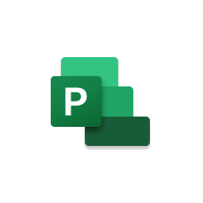



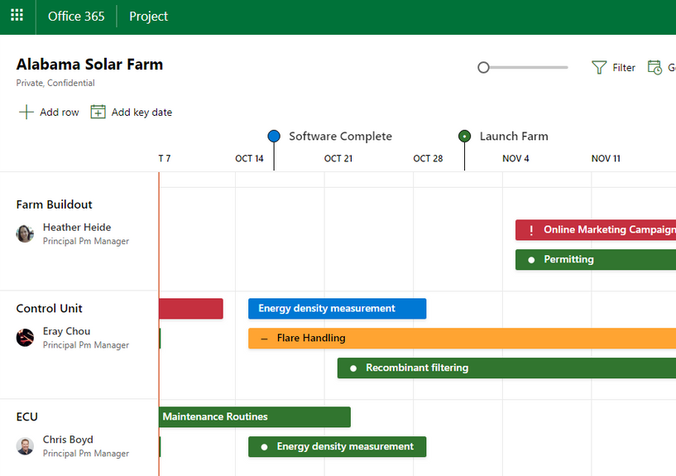


Microsoft Project (stand alone license)
Project Plan 1
Project Plan 3 or Project Plan 5
or
Any subscription with Teams
Roadmap
Project for the web
Roadmap
Project for the web
Project Online
Power Platform
Read-only mode for Project for the web and Roadmap is included in qualified O365 licenses ¹
£7.50 user / month
From £22.60 user / month
For informal project managers
For project and portfolio managers
Roadmap, Grid, Board and Timeline view all available from Plan 1
Free 30-day trial for Project Plan 1 or Project Plan 3
9 Pre-built Power BI Reports for real-time insights²
Fresh new experience
Collaboration made easy
Intelligent insights³
Innovation platform
Quickly kick-off a project, assign tasks and schedules and keep everyone – including your managers – on the same page with just a few clicks.
Keep tabs on all your projects in a single view through Roadmap.
Web access allows your team to collaborate no matter where team members are located.
Enable everyone to update tasks and work simultaneously.
Access, and work on projects directly from Microsoft Teams.
Automate resource management and scheduling and get real-time budget analysis.
Use Power BI and AI Builder models to surface insights on all aspects of your project.
Quickly connect to the apps your team uses and create custom apps to meet the needs of your team³.
Built on the powerful security and compliance capabilities of Azure – the world’s most trusted enterprise cloud.
[1] O365 licenses with view access to Project for the web and Roadmap can be found here
[2] Requires a Power Bi license. More information on pre-built reports is available here
[3] Can require Power BI , Power Apps or Power Automate licenses.

